Slide 1
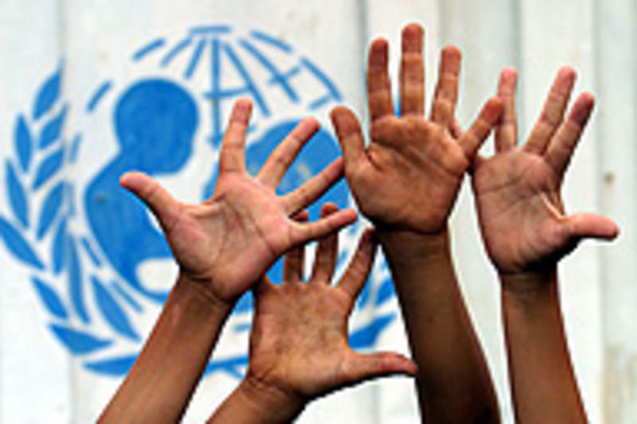
UNICEF
By: Arjun Rasodha 807

Slide 2
What UNICEF Believes
OUR VISION *
Every child. Every Opportunity. No Exceptions.
OUR MISSION *
To mobilize and empower Canadians to invest in the positive transformation of every child's future.
WE VALUE *
Vision, Resourcefulness, Resolve and Inclusiveness.
http://www.unicef.ca/en/discover/who-we-are *

Slide 3
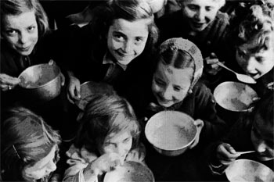
Who is UNICEF?
UNICEF is a global organization that is a child-focused agency which helps children in tough situations
UNICEF stands up for children's rights in almost every country around the world
UNICEF has their main office located in New York

Slide 4
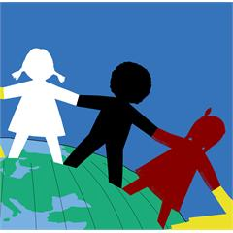
When was this organization started?
United Nations Children’s Fund (UNICEF) started in 1946 after the end of the second world war to help children in devastated countries
In only 60 years of work UNICEF has made a gigantic impact on the lives of many children around the world
UNICEF was started with the idea of giving all children the opportunity to start their lives with the same basic human rights
1964 was a long time ago and a lot of things changed, for example, the worlds population has drastically increased and this results in less food supplies and a more difficult for people in developing countries to live properly

Slide 5
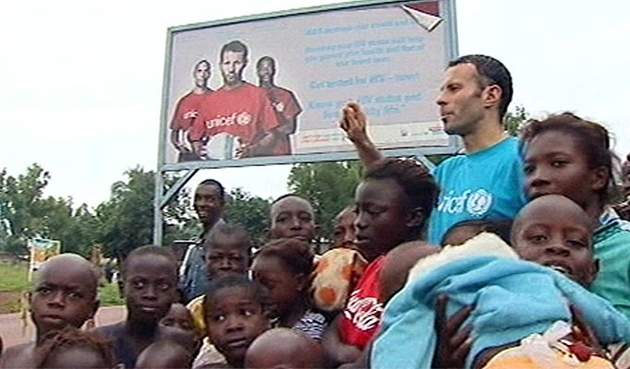
What does the organization do?
UNICEF provides child protection to children all around the world by enforcing laws that protect children's rights
Some laws that UNICEF may help to enforce are laws against poor working conditions or laws that help children from being forced to become soldiers
UNICEF also helps children meet their basic needs and strive to reach their full potential
UNICEF provides help to children in 156 countries
UNICEF helps children in developing countries by providing them with health and nutrition, education, child protection, water supply and sanitation

Slide 6
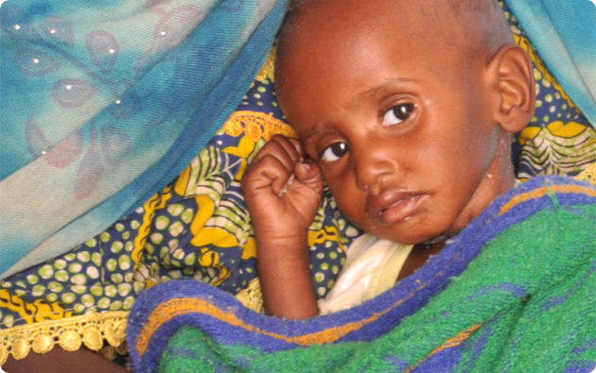
Why is this help necessary? What is the problem or issue UNICEF is trying to help?
UNICEF helps children that are being mistreated and taken advantage of. If UNICEF was not doing this then these children would grow up and live their whole lives being mistreated
The lives of children in developing countries are very poor and UNICEF has noticed this. This is why UNICEF is spending time and money helping these children have better lives.
UNICEF has already made an incredible difference in the lives of many children. 10 Years ago 70,000 children died a day but today with the help of UNICEF that number has been reduced to less than half.
This group is saving lives and changing the future for millions of children around the world
UNICEF is helping children with their rights. These children haven't done anything wrong yet they are continually being mistreated, abused and taken advantage of.

Slide 7
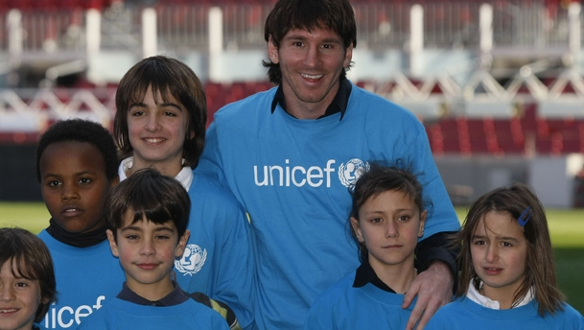
How does UNICEF provide aid? What types of things do they do ?
UNICEF is different from most NGOs. UNICEF is considered to be a team made of different governments. UNICEF has a government connection which allows them to take action quickly. UNICEF is allowed to use government vehicles and guard their warehouses with police. Government connections is a great advantage for UNICEF that many other organizations do not have. UNICEF officials can use locals halls, hospitals and schools for their events.
UNICEF is also highly supported by donations and volunteers

Slide 8
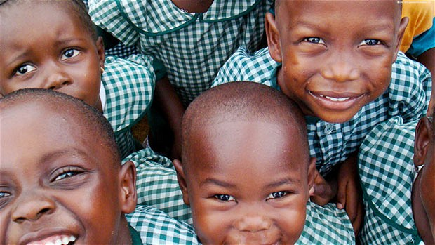
What difference has UNICEF made?
10 Years ago 70,000 children died a day, but today, with the help of UNICEF it has been reduced to less than half
30 Years ago every 1 out 4 children had died before becoming five years old. Now with the help of UNICEF it has become only 1 out of 10
In 1980, ten percent of the children in the world were given their shots to be immunized against six deadly diseases, but with the help of UNICEF it is now 75 percent
Notes:
ow

Slide 9
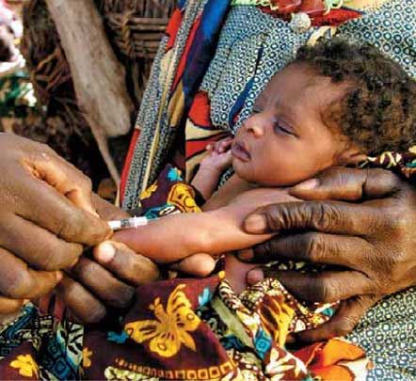
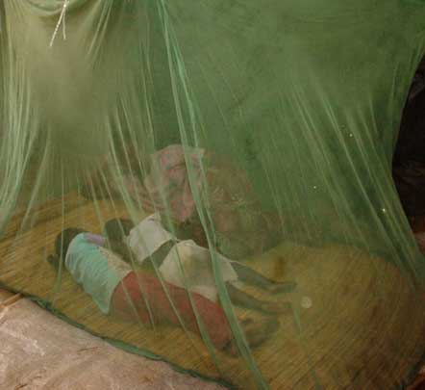
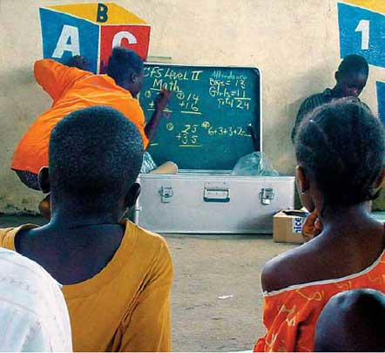
Facts About UNICEF
UNICEF gives vaccines to almost 40 percent of the world’s children population. That is about 3 billion shots yearly
This organization is the biggest buyer of mosquito nets. They bought 25 million mosquito nets in 2006
With UNICEFs support and school supplies, about 12 million children were able to go back to school in 2006

