Slide 1
Compost Magic
Mrs. Lowe’s 2011-2012 Amazing boys and girls present:
RED WORM WIGGLERS

Slide 2
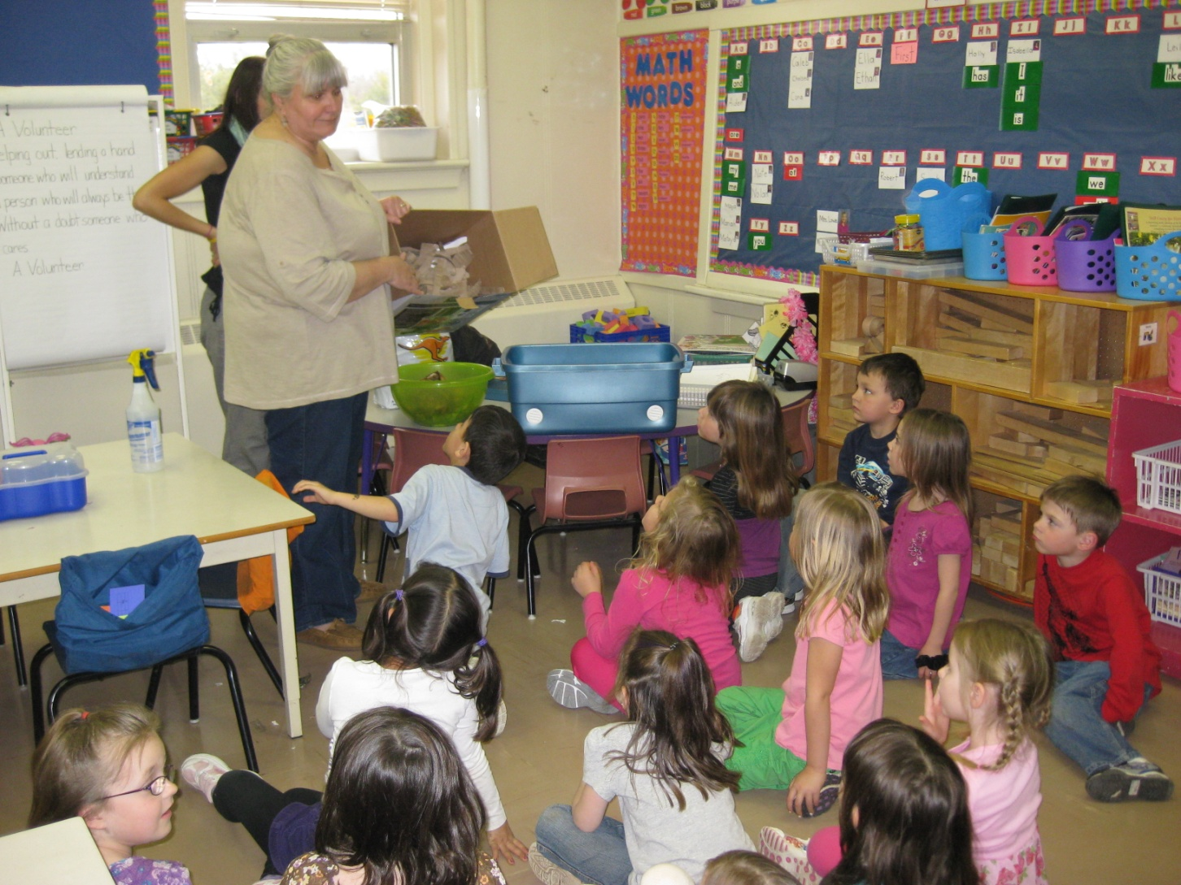
Preparing For Arrival

Slide 3
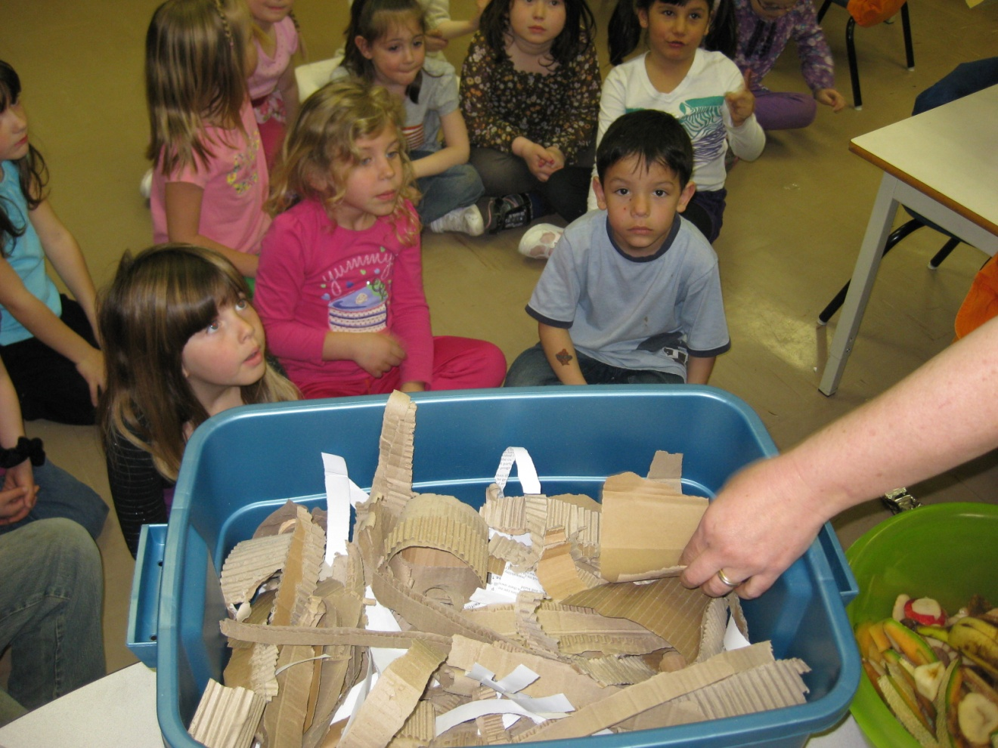
First add the bedding.
Even worms need a warm place to snuggle.

Slide 4
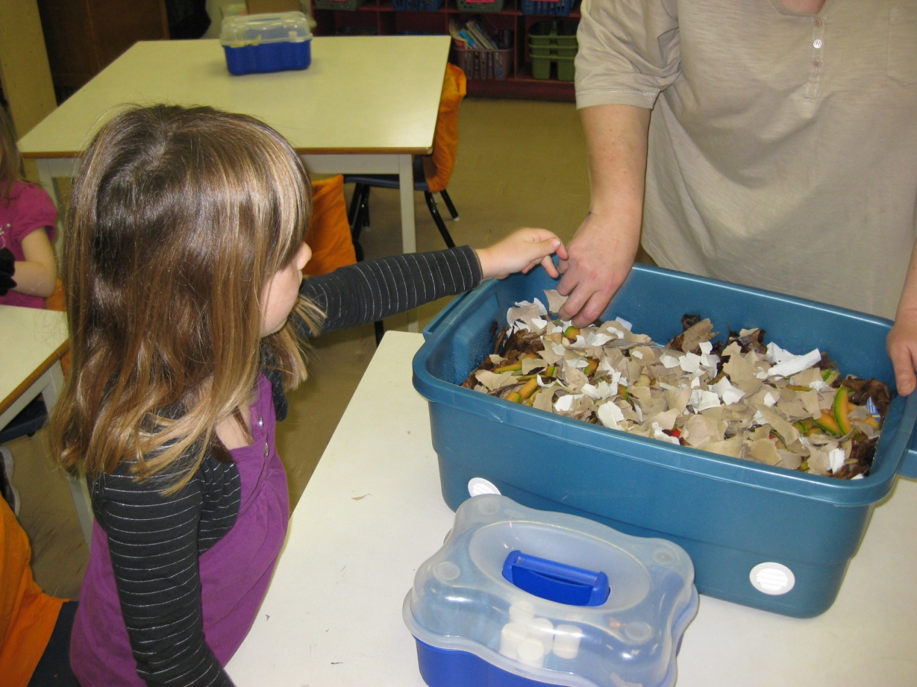
We made sure the paper was in small pieces. After all…worms have no teeth!

Slide 5
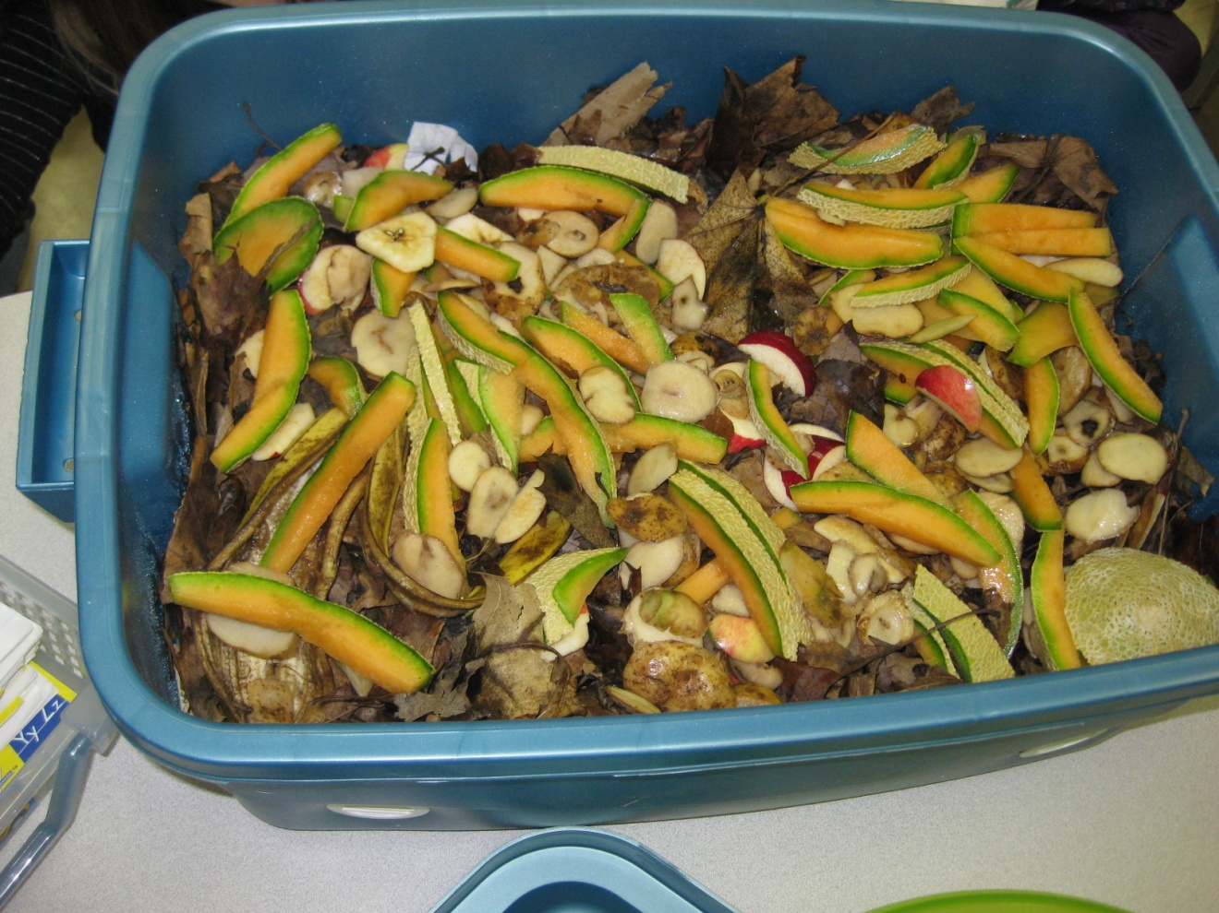
Then came the fruit. Red worms LOVE the fruit from our breakfast program just as much as we do!

Slide 6
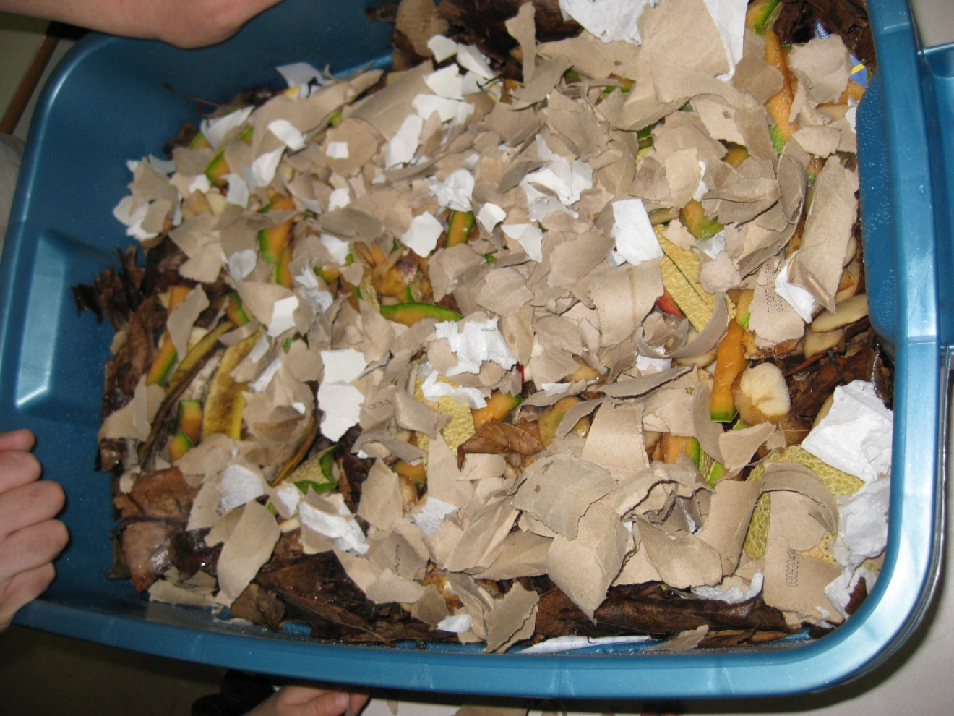
Once the layers were in, we sprayed it with some water to make it nice and juicy for the worms.

Slide 7
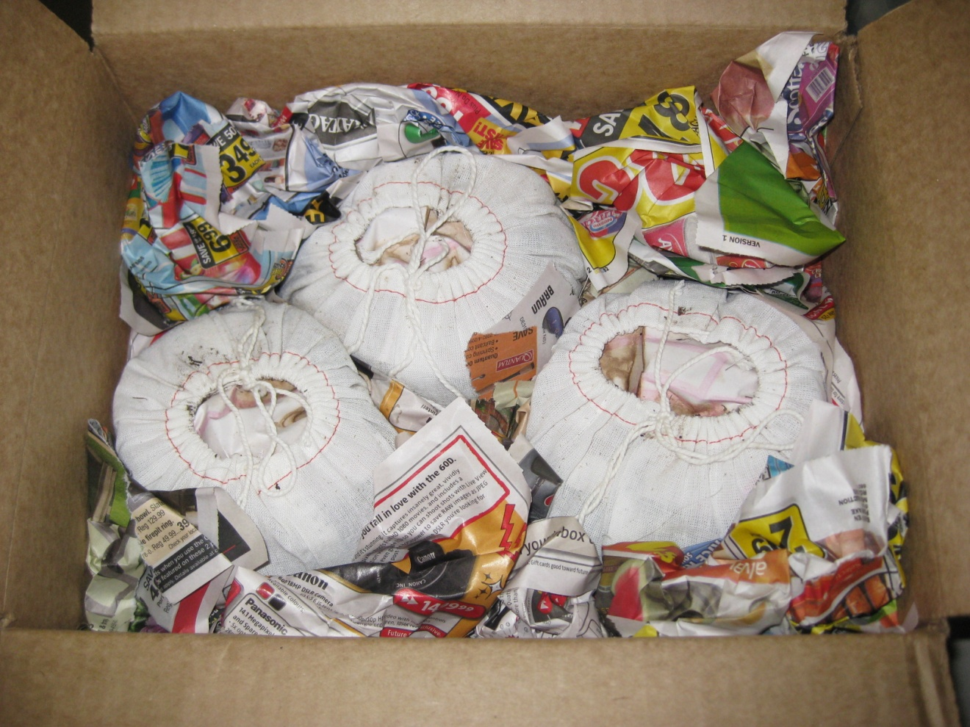
Can you guess what’s inside????

Slide 8
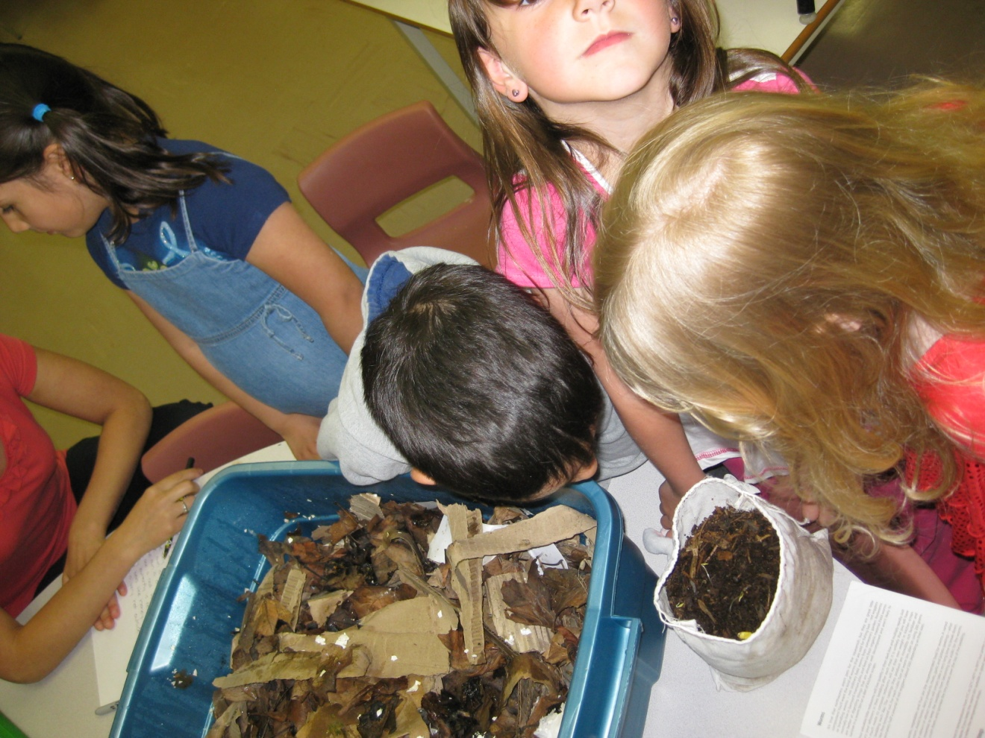
It was an exciting day when the worms arrived.

Slide 9
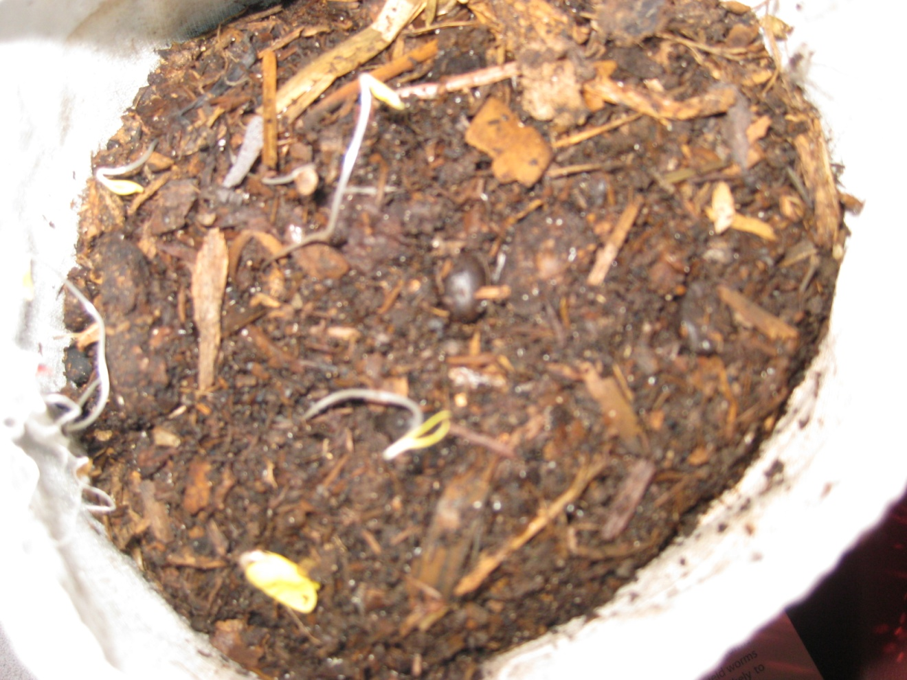
The organic soil that they travel in was the perfect addition to our class compost bin.

Slide 10
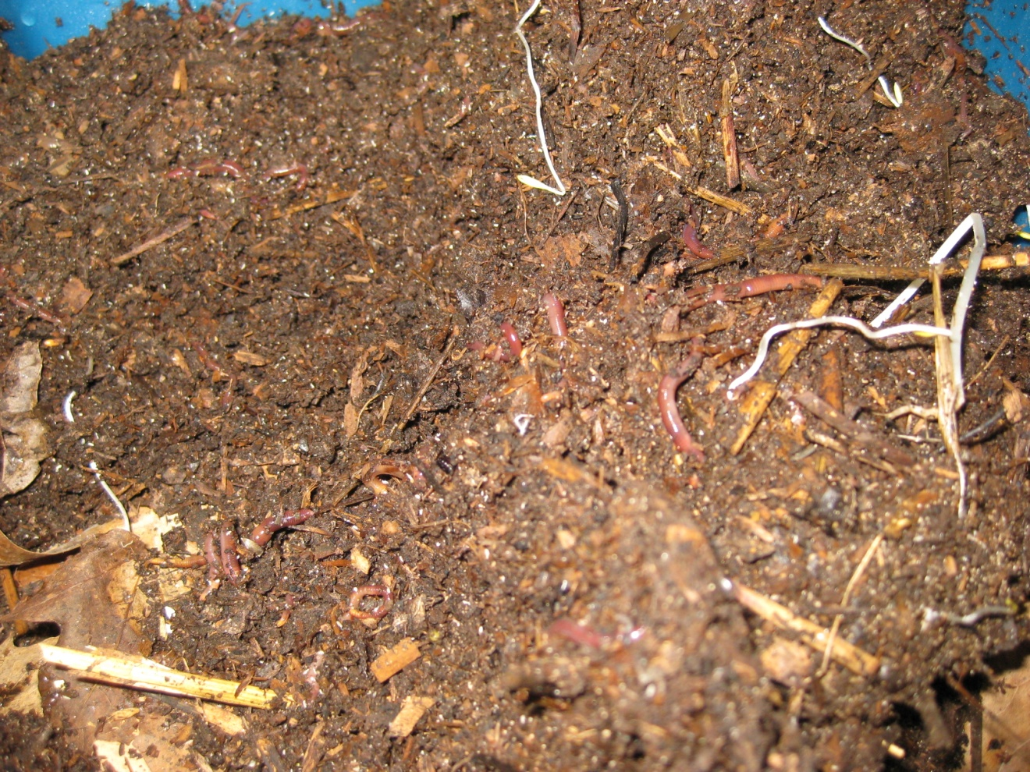
Busy, busy, little worms.

Slide 11
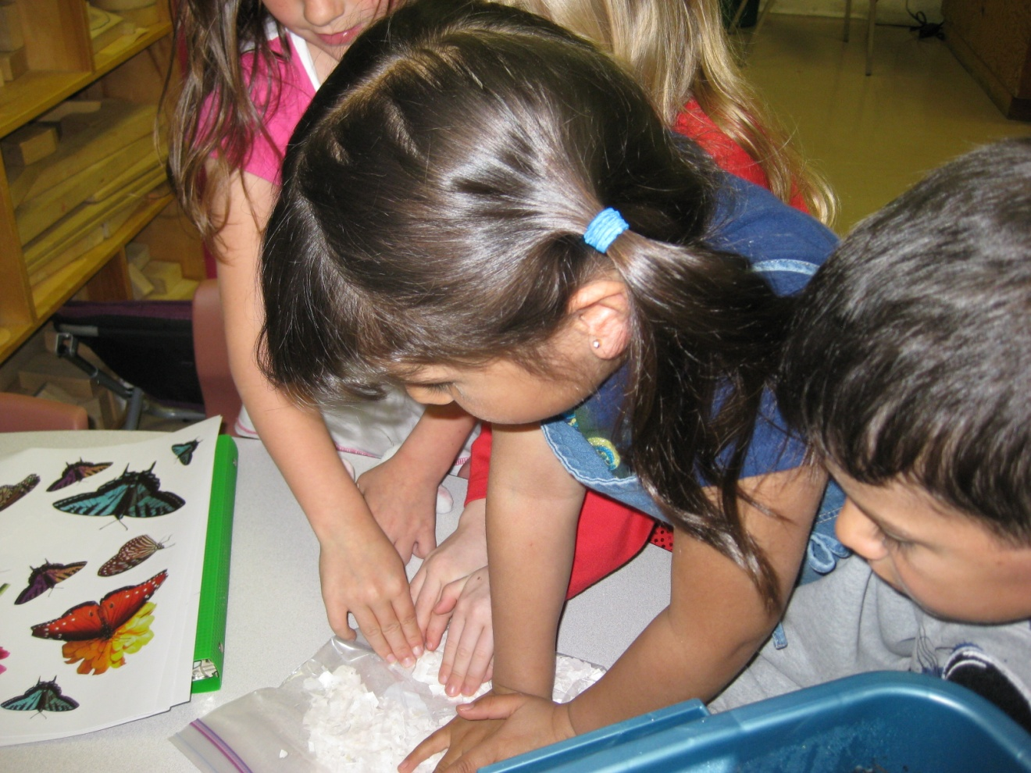
Crushing egg shells to feed the worms.

Slide 12
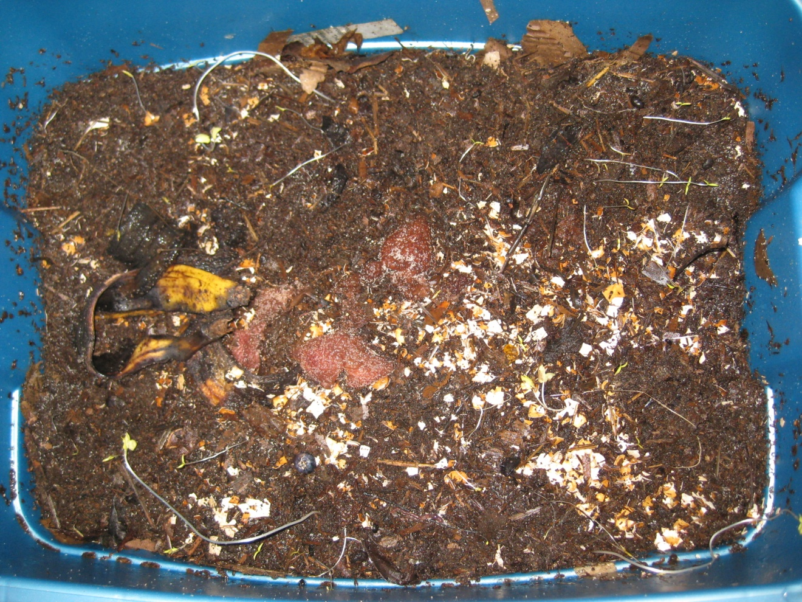
That’s one good lookin compost pile! And it smells good too!

Slide 13
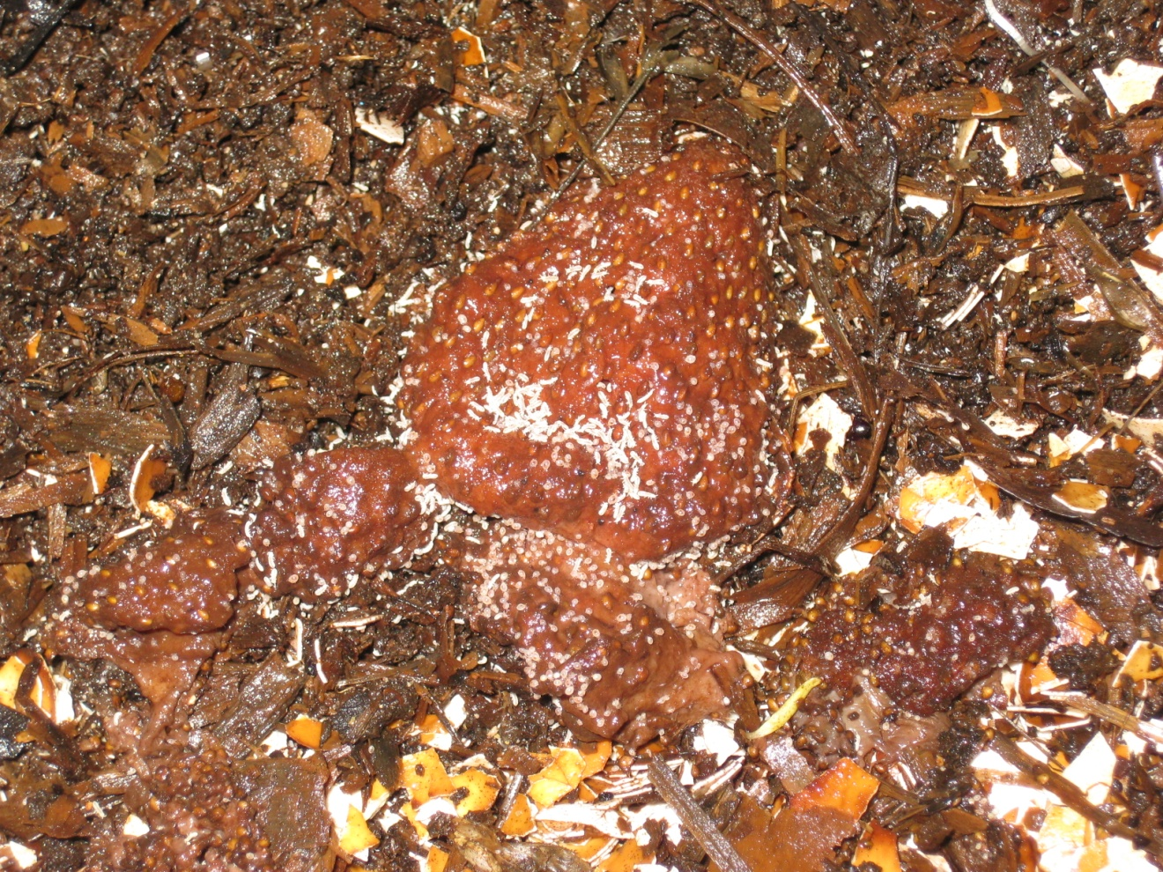
Baby worms love strawberries too.

Slide 14
Kindergarten Had Some Worm
To the tune of "Old McDonald's Farm “
Kindergarten had some worms, in a compost bin.
And all these worms made healthy soil, in a compost bin.
With a squiggle, squiggle here and a squiggle, squiggle there,
Here a squiggle, there a squiggle everywhere a squiggle, squiggle.
Kindergarten loved their worms
In their compost bin.
Author Unknown

Slide 15
We sure did learn a lot about Red worms, and how important and easy it is to compost.
REDUCE, REUSE, RECYCLE AND COMPOST!!

