Slide 1
Project Based Learning at morell Regional high school
Global Issues 621

Slide 2
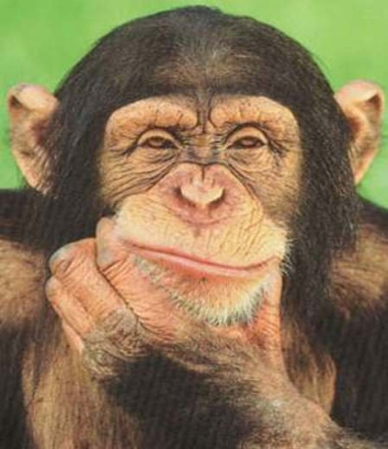
What is PBL?
Project-Based Learning is an instructional method that provides students with complex tasks based on challenging questions or problems that involve the students' problem solving, decision making, investigative skills, and reflection that includes teacher facilitation.
PBL is focused on questions that drive students to encounter the central concepts and principles of a subject hands-on. Students form their own investigation of a guiding question, allowing students to develop valuable research skills as students engage in design, problem solving, decision making, and investigative activities.
Through Project-Based Learning, students learn from these experiences and take them into account and apply them to the world outside their classroom. PBL is a different teaching technique that promotes and practices new learning habits, emphasizing creative thinking skills by allowing students to find that there are many ways to solve a problem.

Slide 3
PBL at Morell Regional High: All you need is a ‘Guiding Question’
A guiding question can encompass a lot of things, but students will decide themselves how they wish to answer it. Guiding questions should not be too broad, or too narrow. Our Global Issues 621 class’ guiding question was:
How can we help make a positive difference in our world?

Slide 4
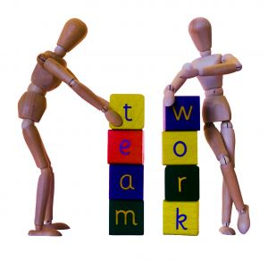
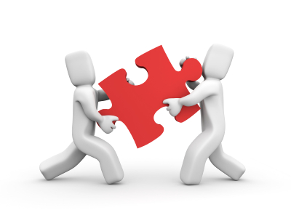
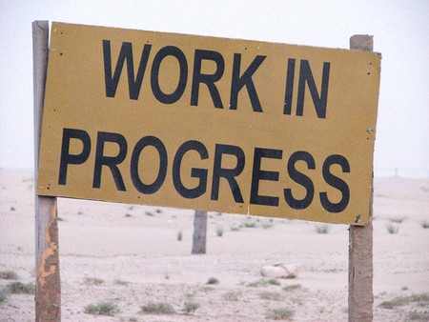
Then students got to work…
Students divided themselves up into groups of their own choosing and began brainstorming ideas together. They decided to help the following groups:

Slide 5
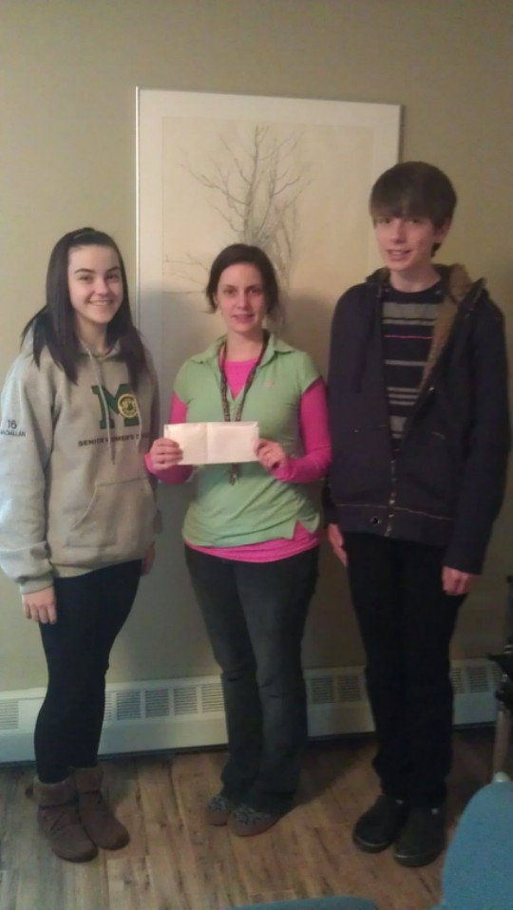
Maddie & Jordan:
Anderson House
$300
“Our final action was Tuesday, January 17th when we finally met our SME, Danya, and took our donations and a total cash donation of $300 into Anderson House. We had eight pillows that we bought, six cases of juice donated by Pepsi and the bags and boxes full of food and even some clothing from the church food drive!”
-Maddie & Jordan

Slide 6
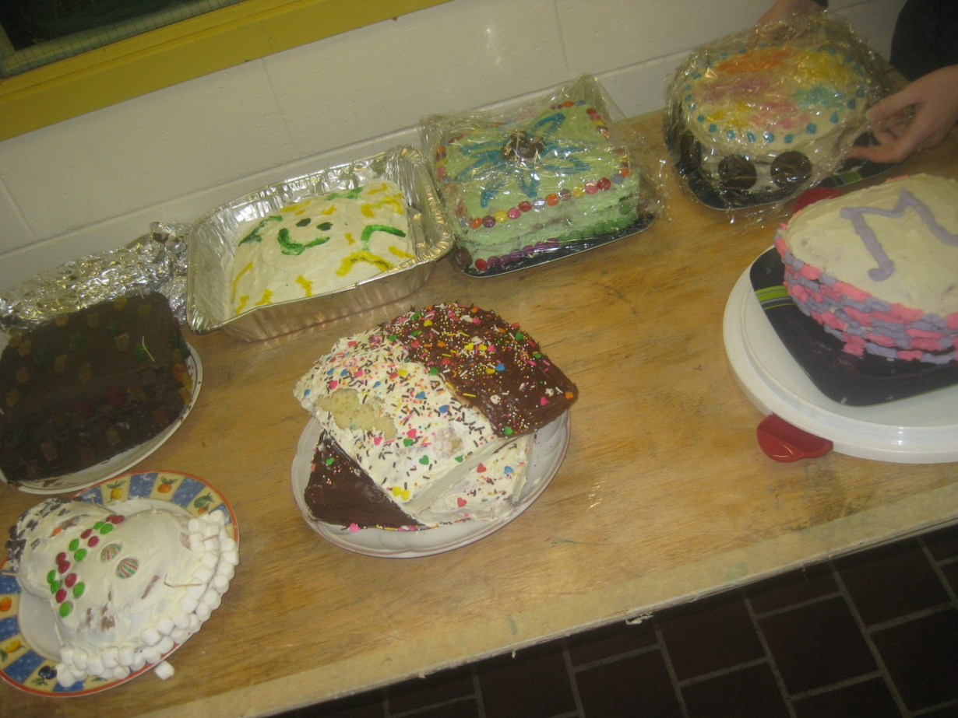
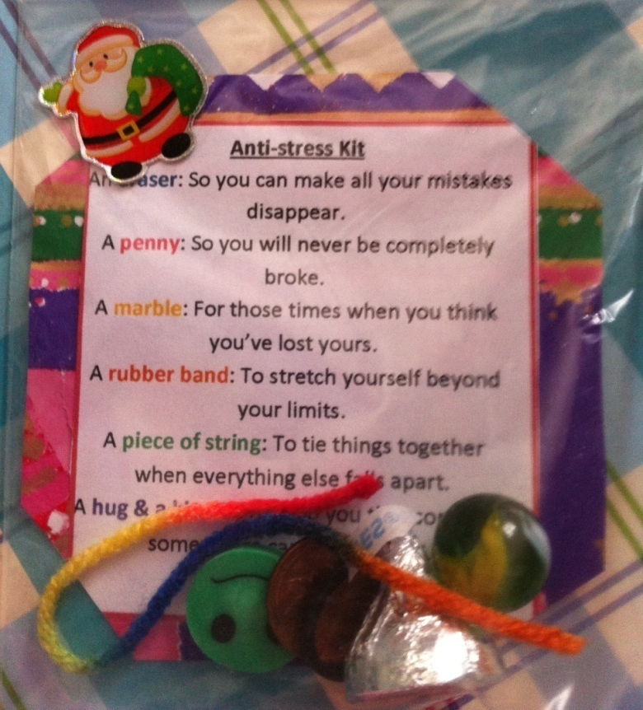
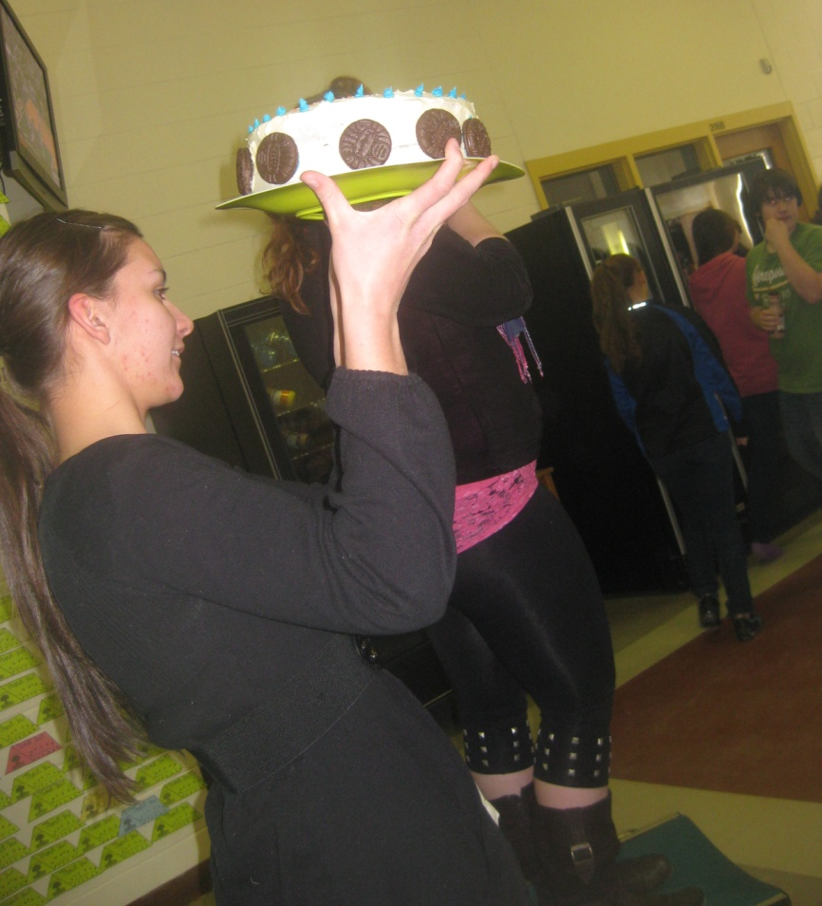
Michaela & Leah:
CAT Action Team

Slide 7
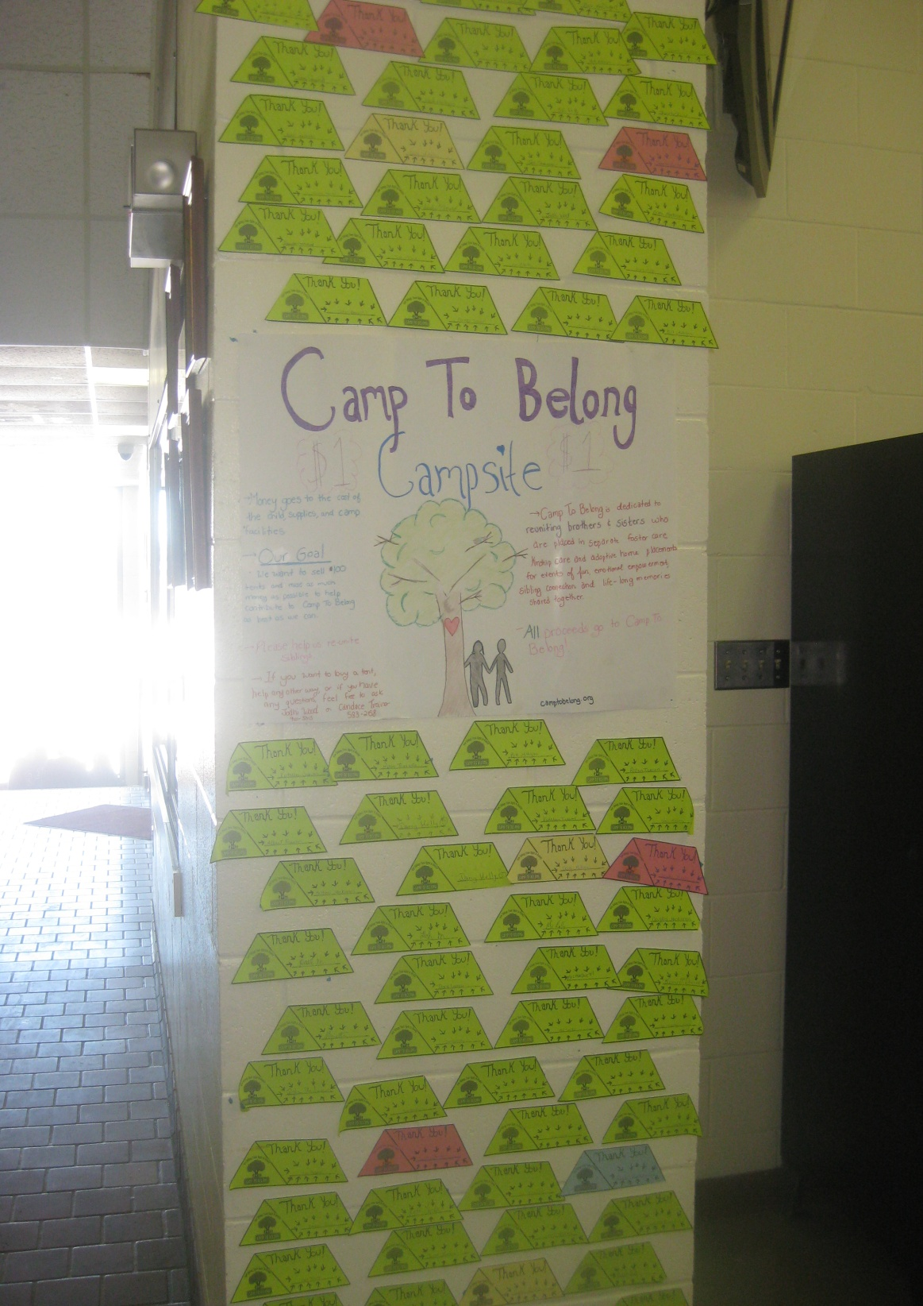
Jodhi & candace:
Camp to belong

Slide 8
Connor, Mark & Seth:
KidSport

Slide 9
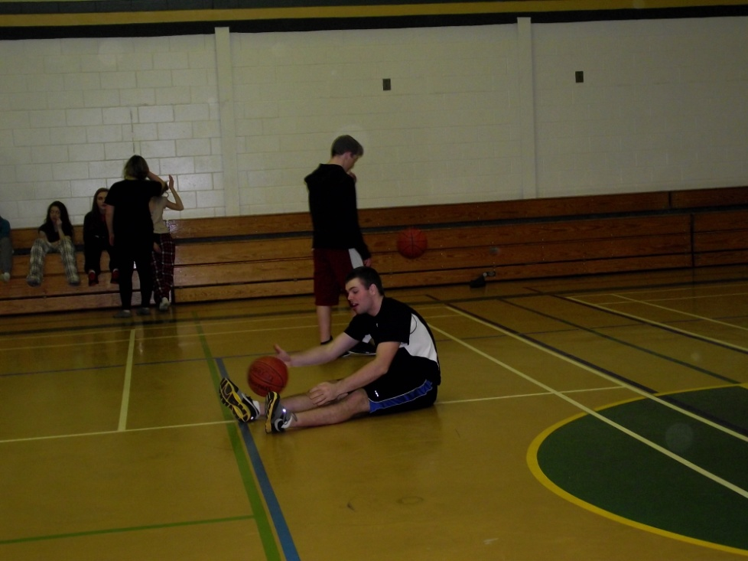
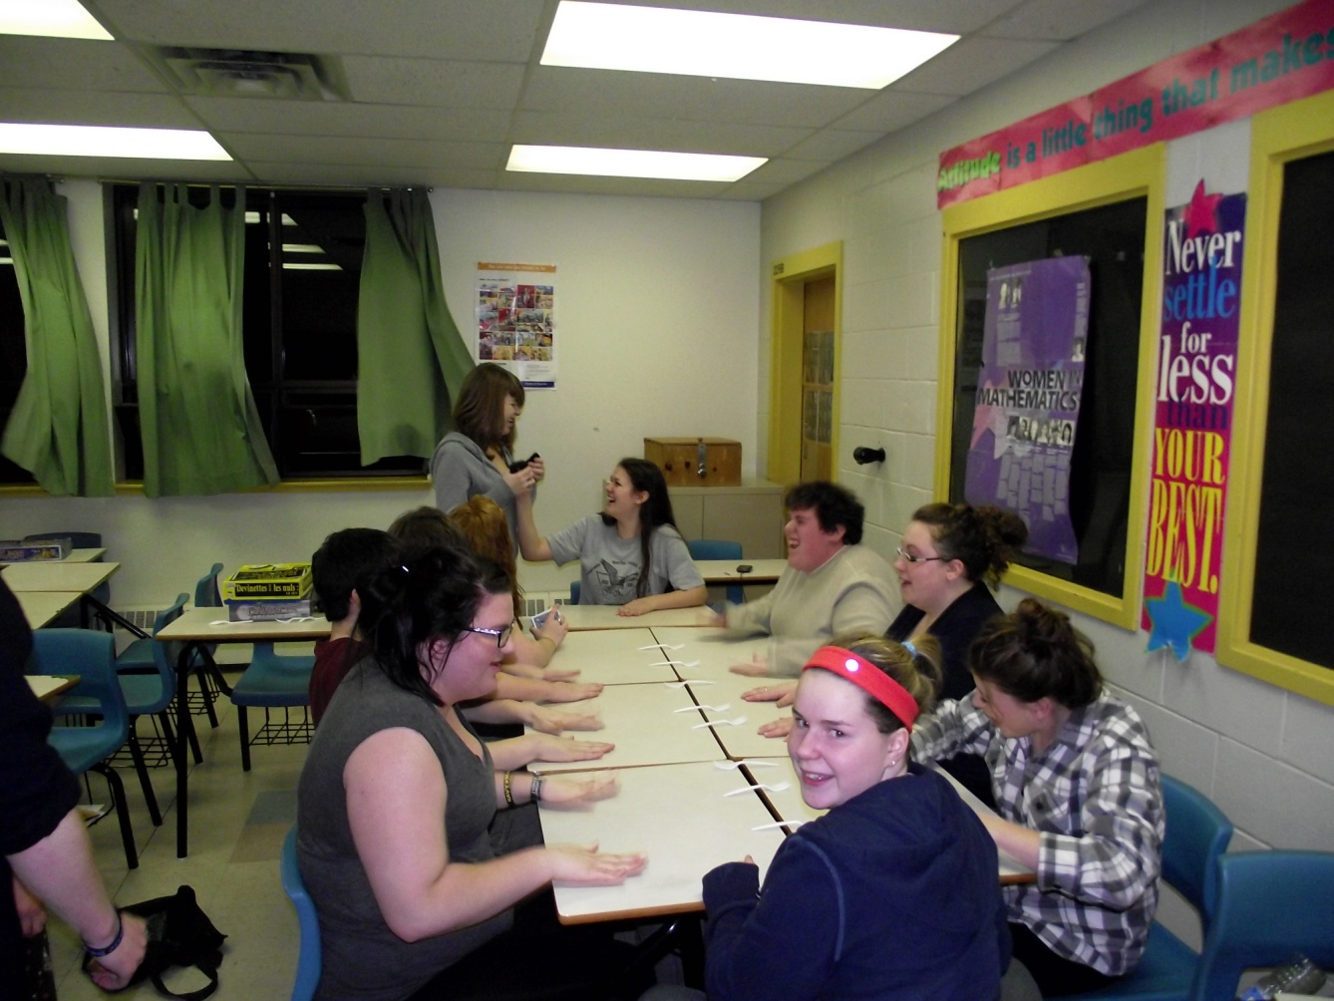
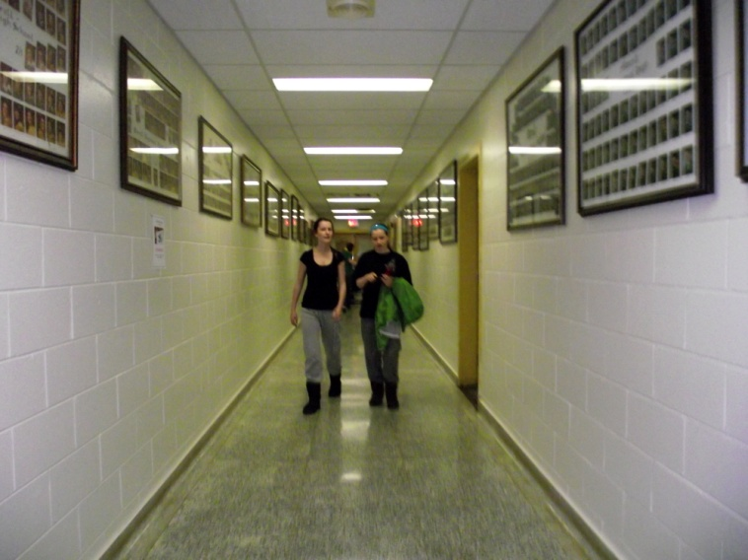
Sam, Chad, Geoff & Zack:
World Vision

Slide 10
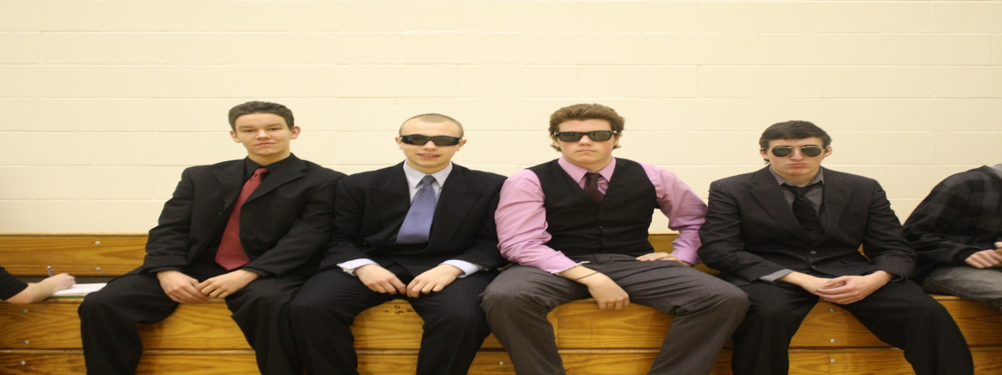
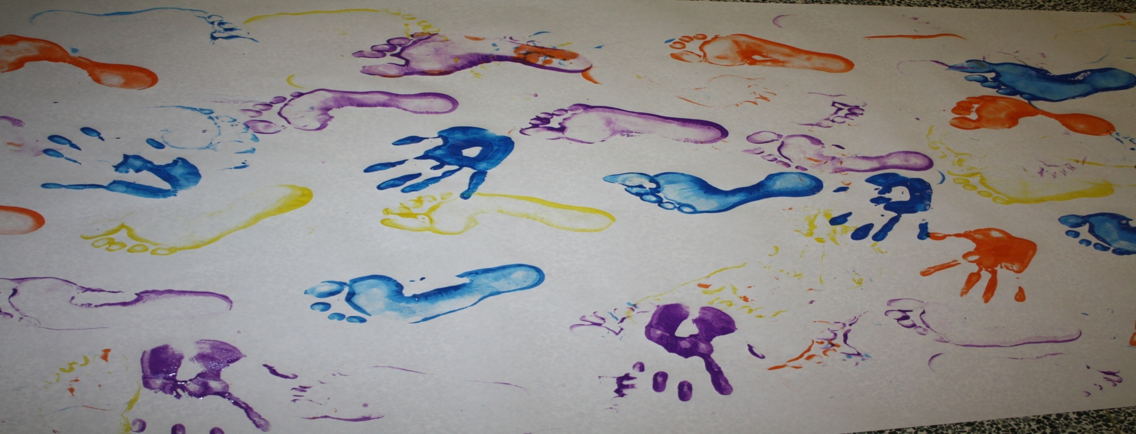
Formal Friday
Be The Change Banner

Slide 11
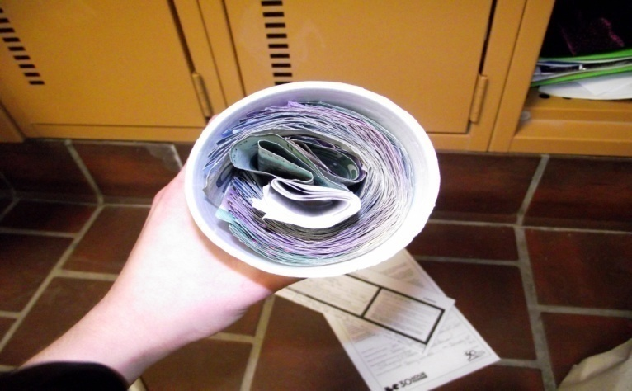
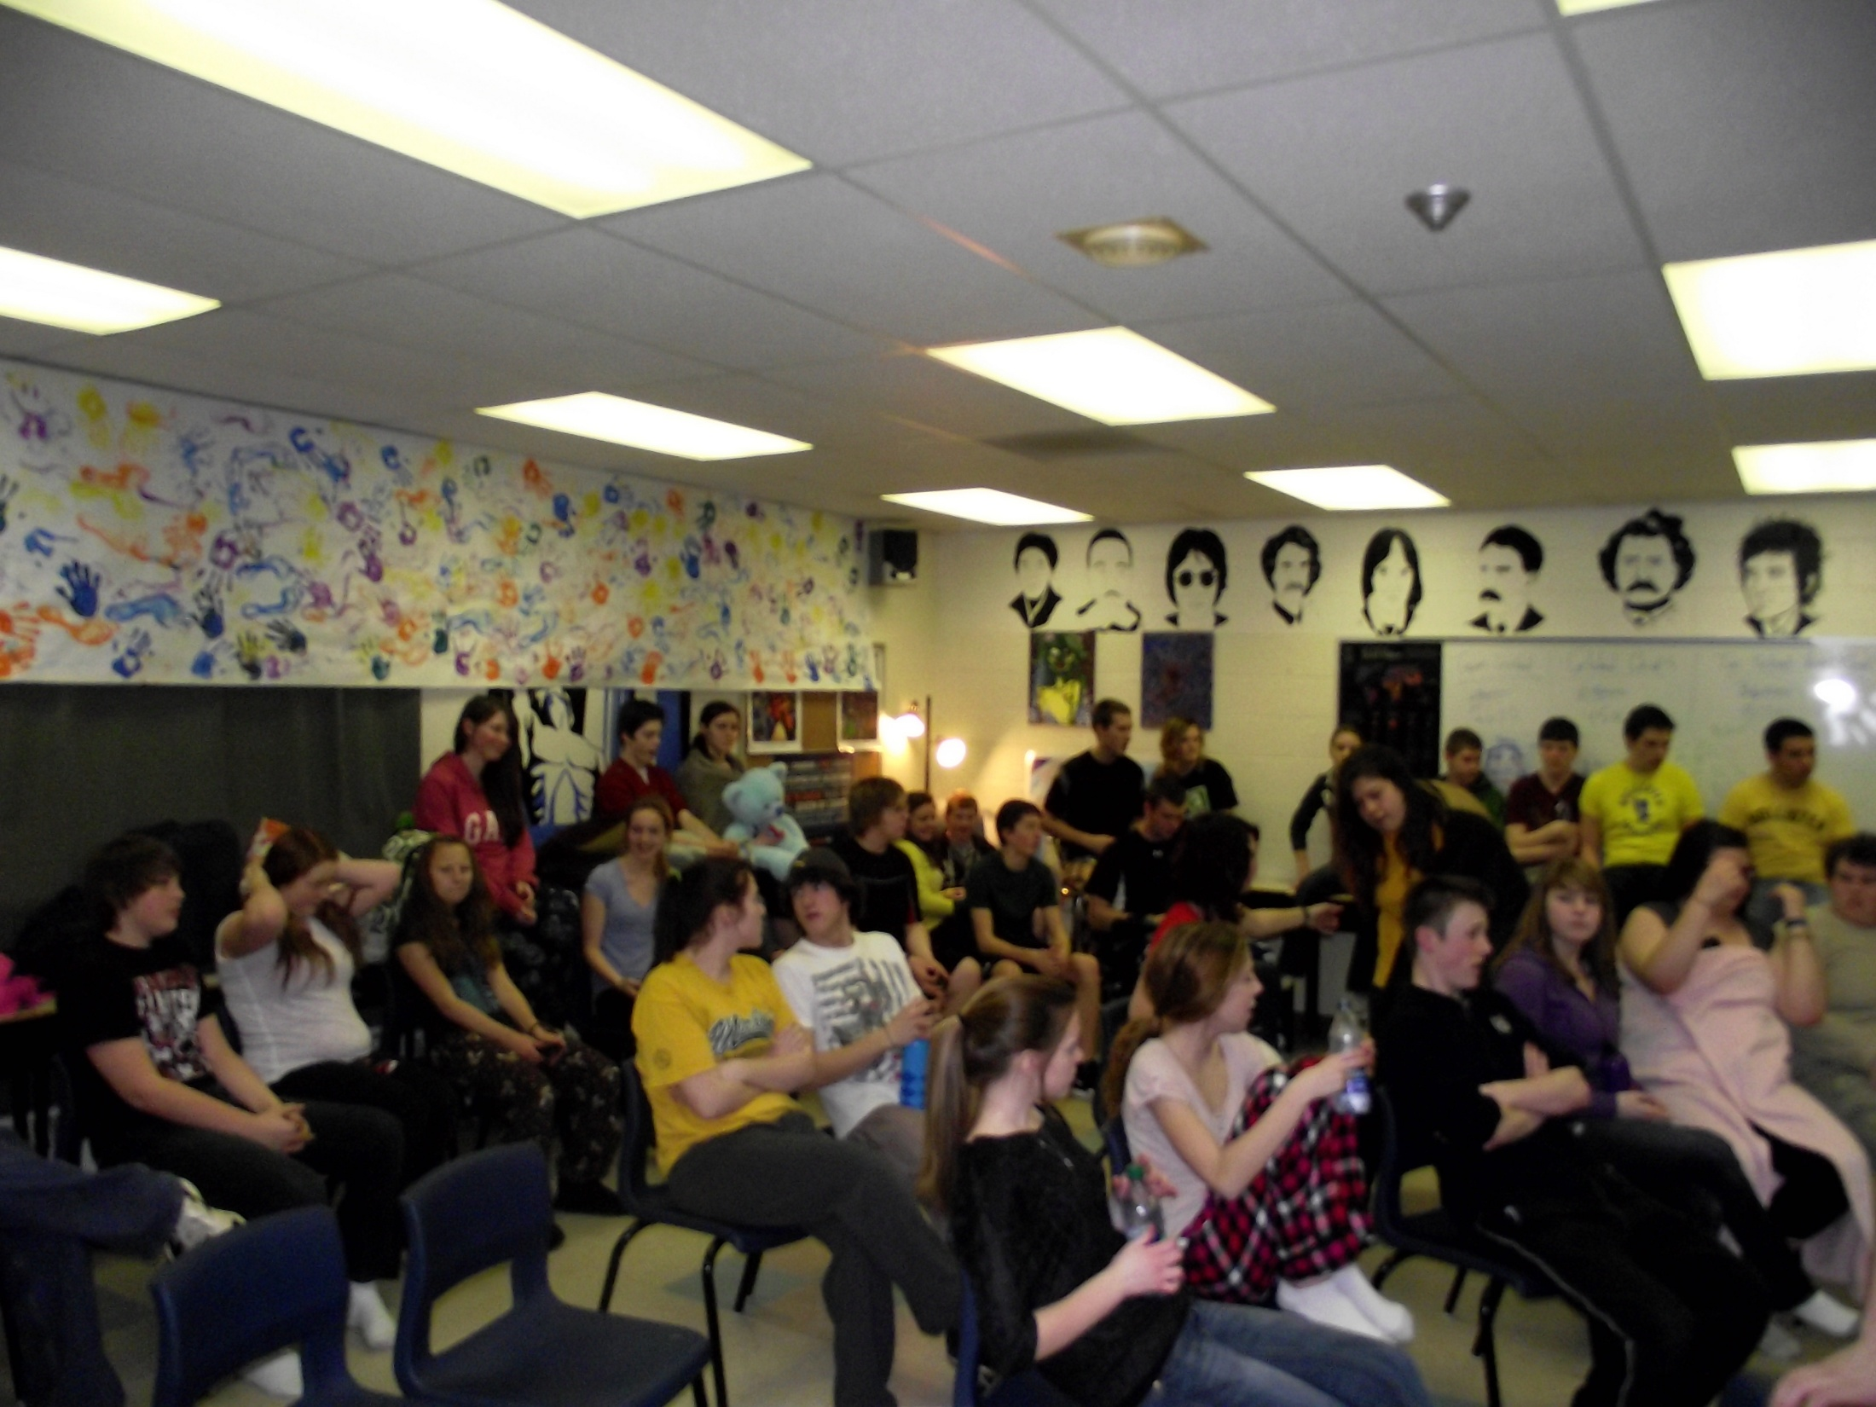
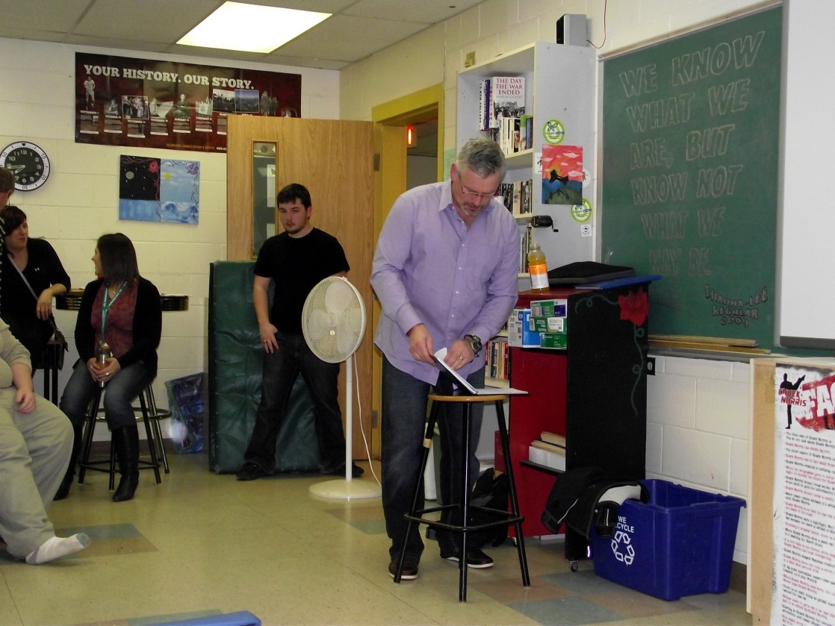

Slide 12
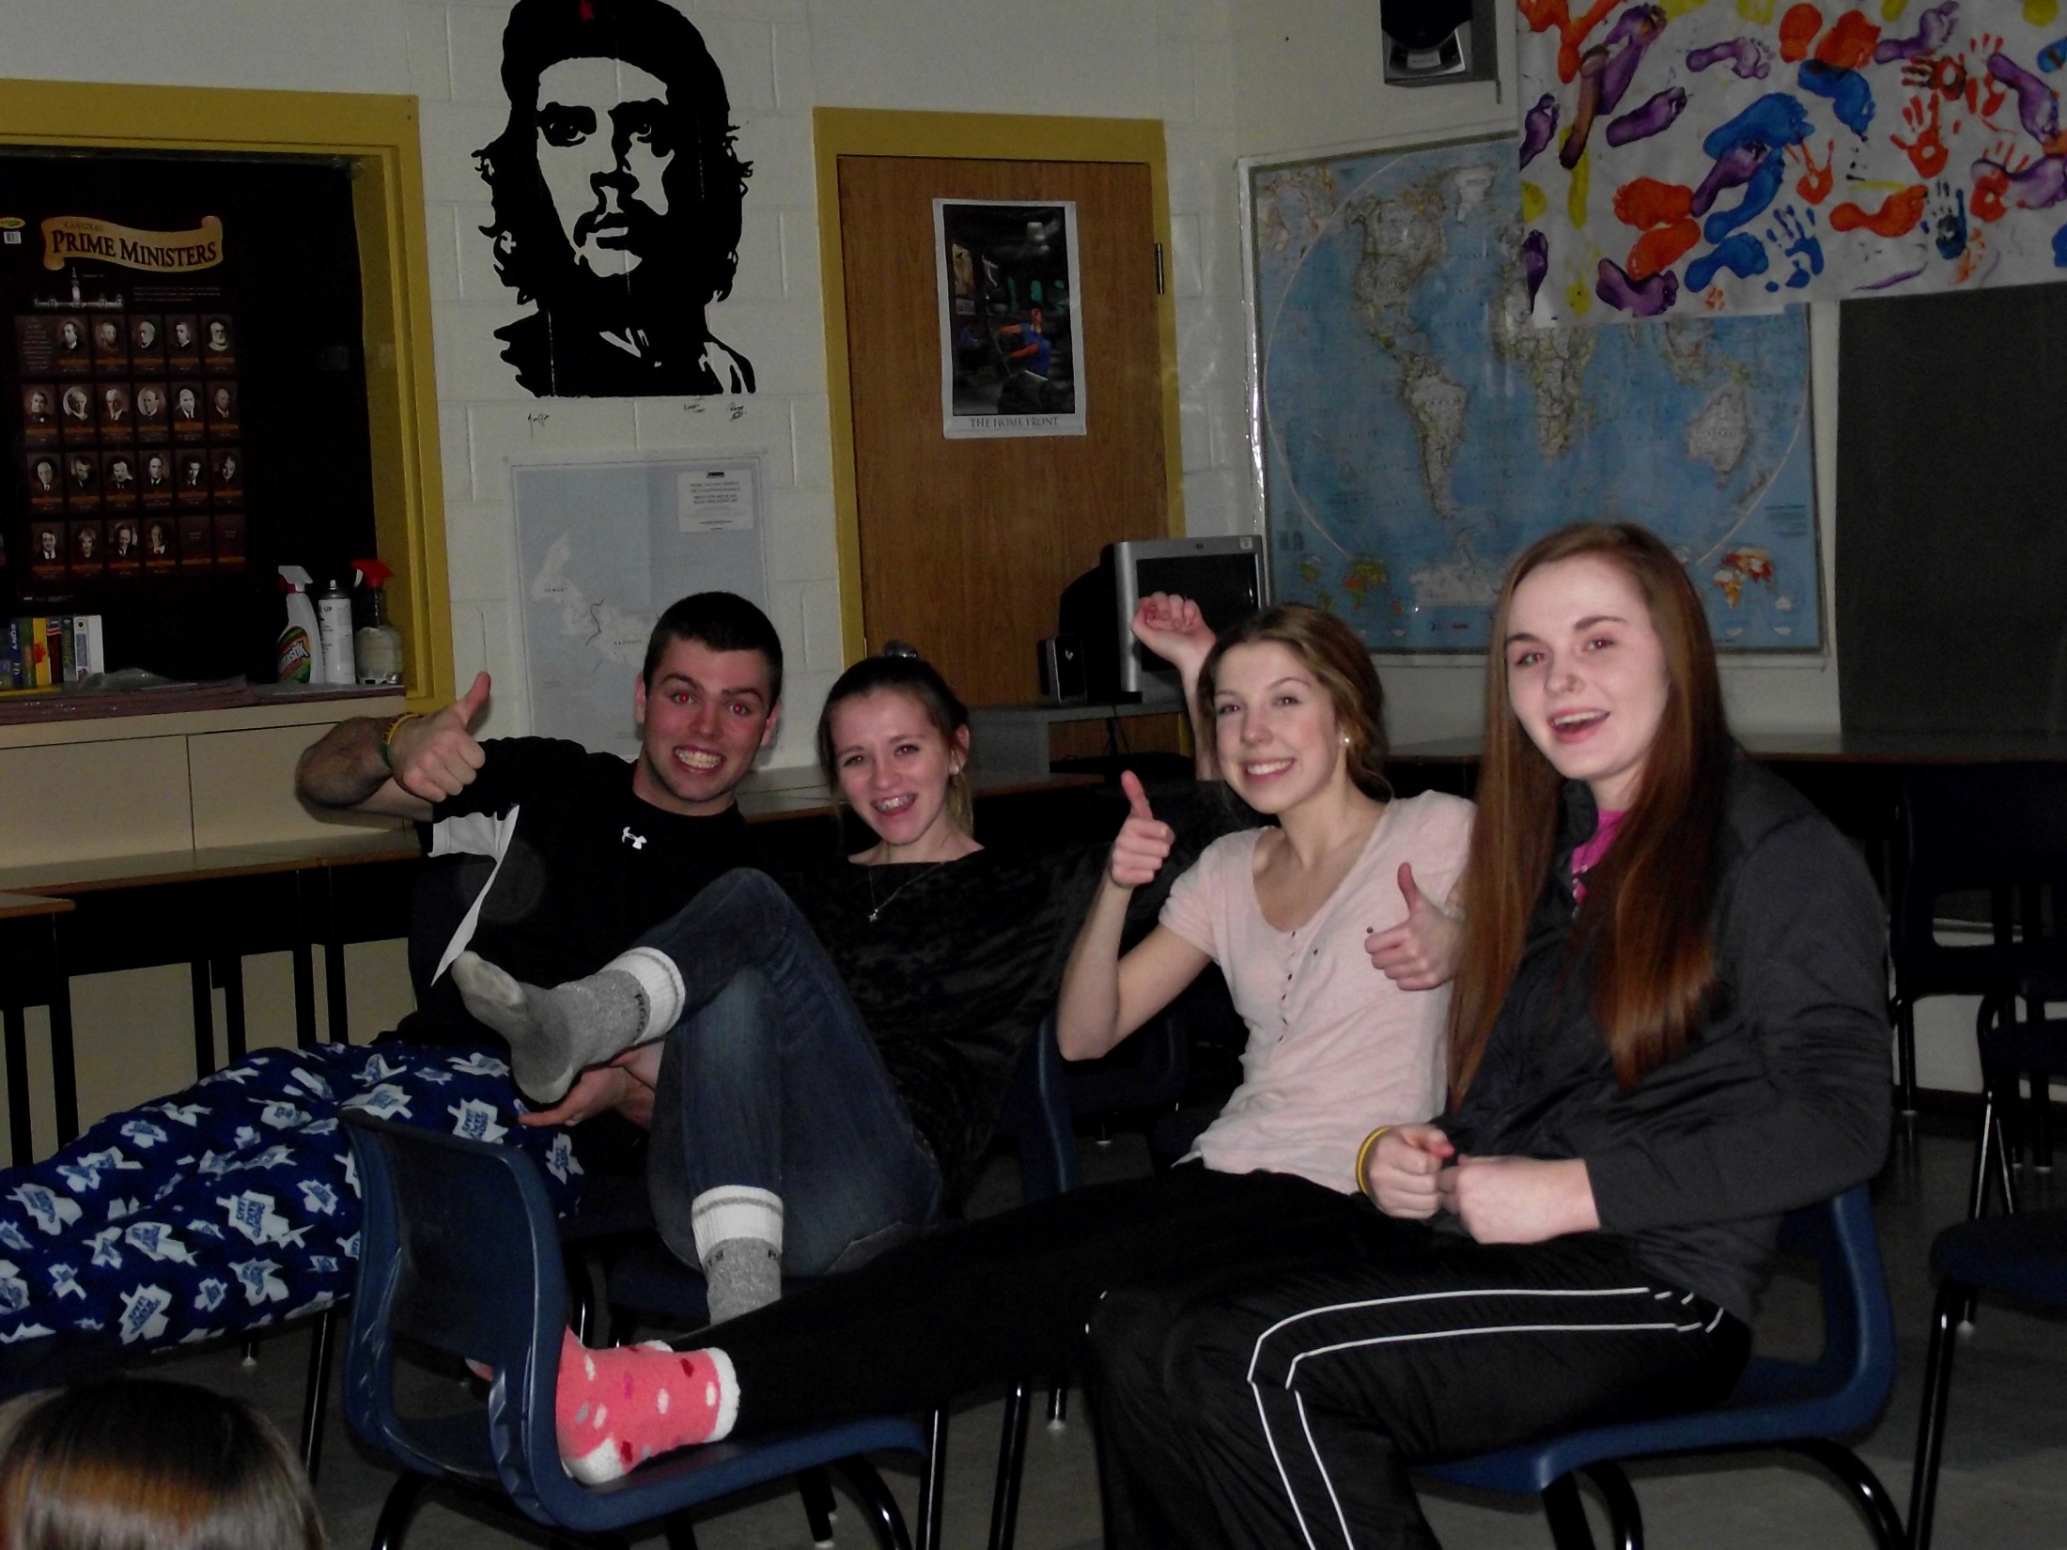

Slide 13
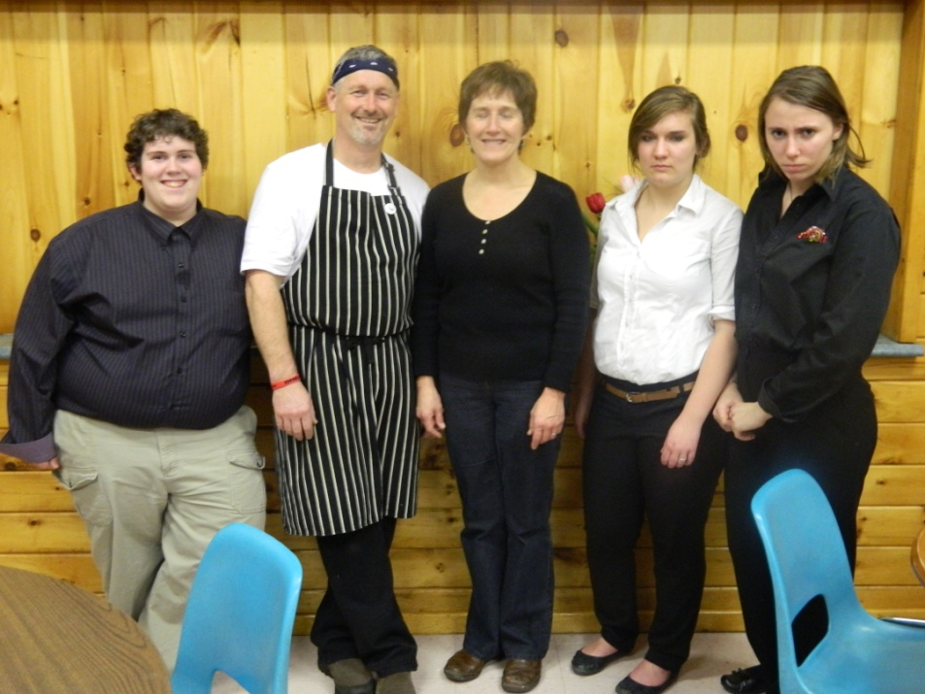
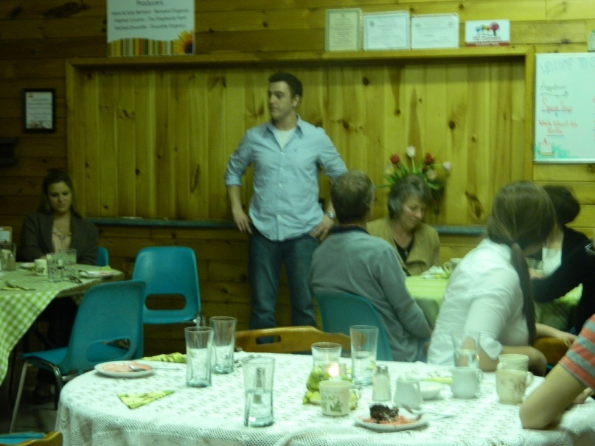
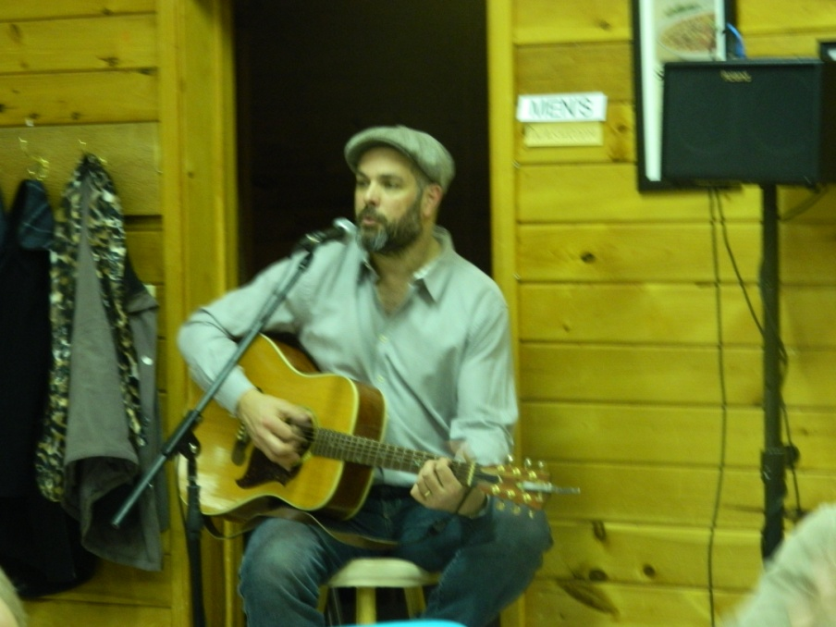
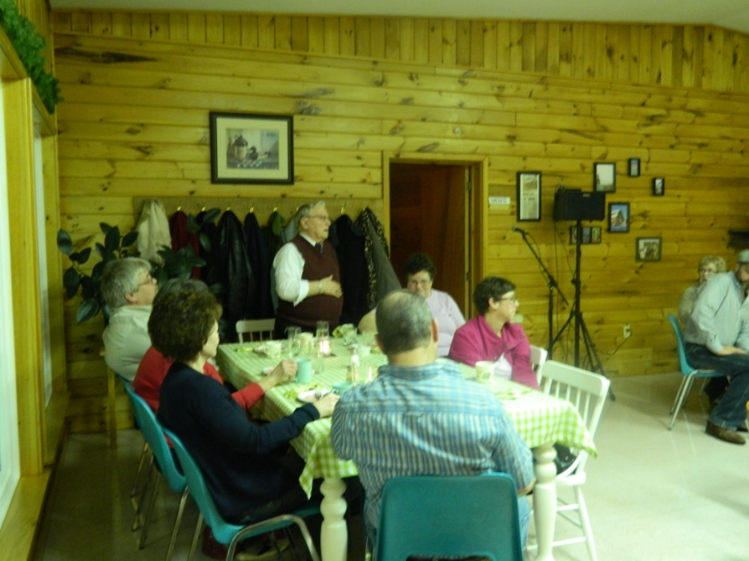
Dylan & Jessica:
CHALICE

Slide 14
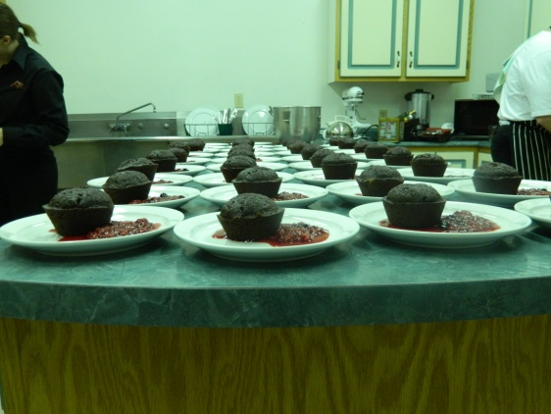
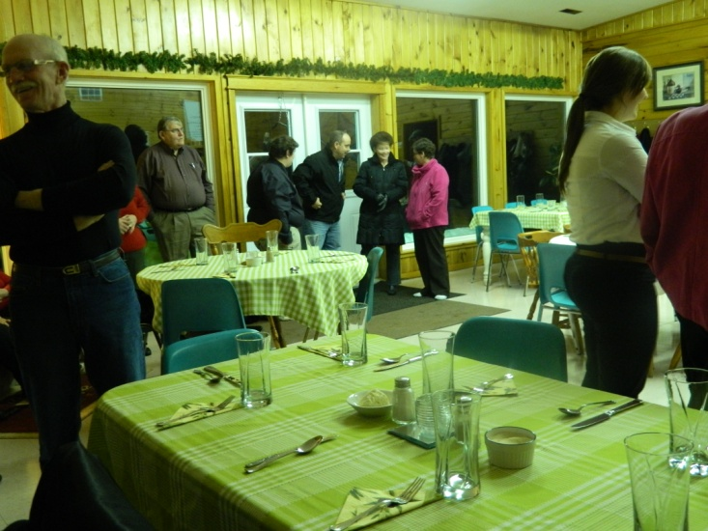
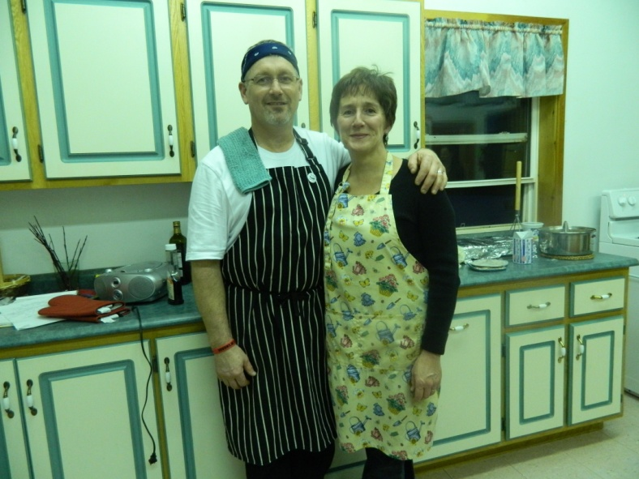
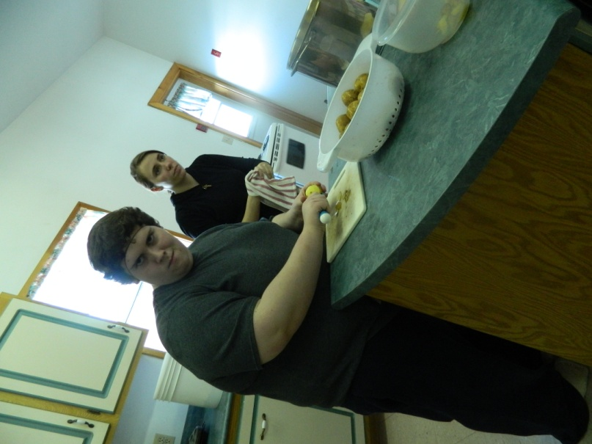
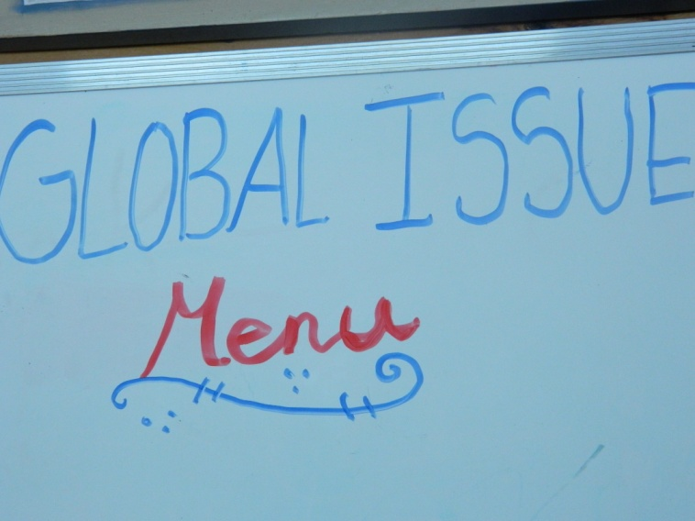
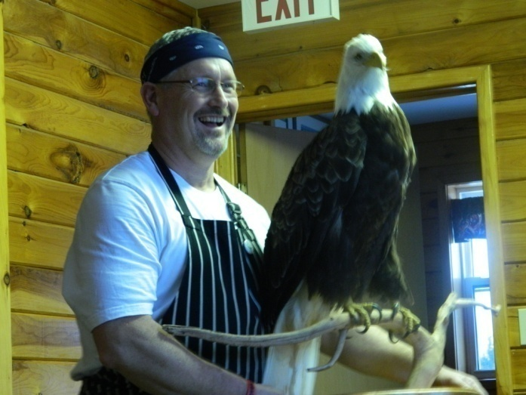

Slide 15
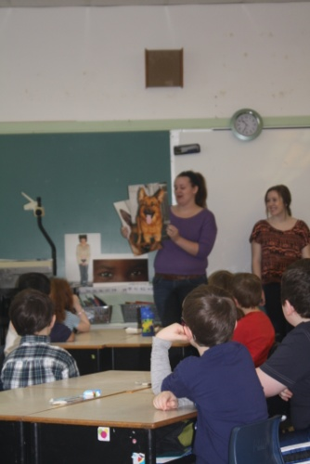
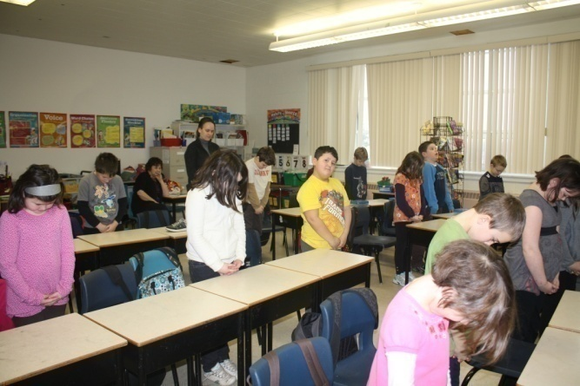
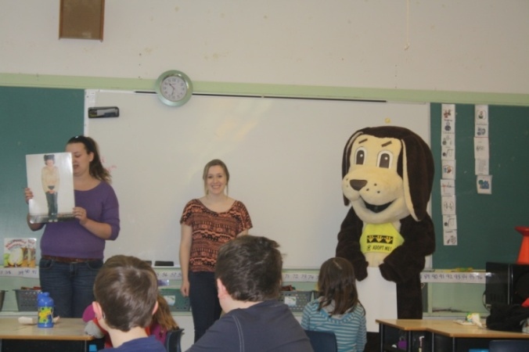
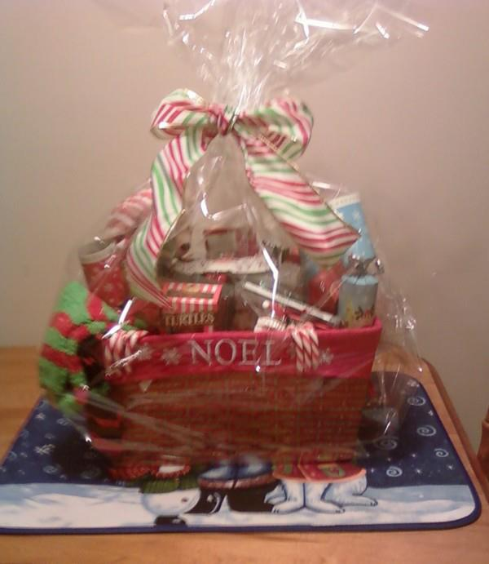
Kelsey, Avery, Bethany & Kaitlyn: PEI Humane Society
Ideas for Fundraising ( Plan #1)
- Pull Tabs
- Christmas Basket
- Bagging Groceries
- Bottle Drive
- Pet Supply Drive
Doggone Safe Presentation (Plan #2)
- Presented to Morell Consolidated, Grades two and three.

Slide 16
High-Fives!

Slide 17
Doggone Safe Presentation

Slide 18
These students really enjoyed it

Slide 19
A very proud moment for our girls…

Slide 20
And of course…
Alex-Sandrea, Courtney & Rachael:
The Pink Glove Dance for the QEH

Slide 21
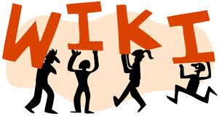
With nine different groups all working on
various projects, how do you keep track of their progress?
kellywiki
21st century Learning

Slide 22
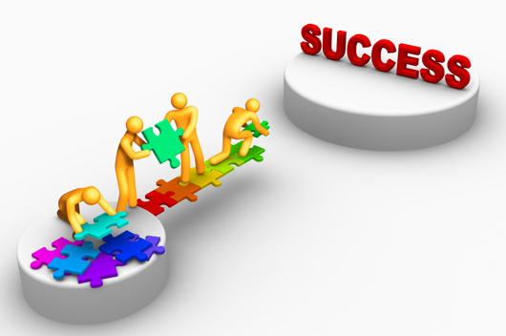
What is the value in this for students?
My students really enjoyed carrying out these projects and learning the value of becoming more active in their school and community. Most of them didn’t see it as regular ‘schoolwork’, however they are learning important skills that will be useful to them in many aspects of their lives.
“Some problem solving skills we
Enhanced during this project was how
to organize and accomplish our goals when
we also had other projects, school commitments,
exams, and work that needed to be completed.”
“We achieved more than we ever thought we would. Our communities were happy to help out and donate to the PEIHS because it was something they could relate to.”
“Our PBL experience is definitely something we’re
going to take with us out of this course and after this
year. It’s taught and shown us so much and we’ve
honestly learned a lot more then we realized we would.”

Slide 23
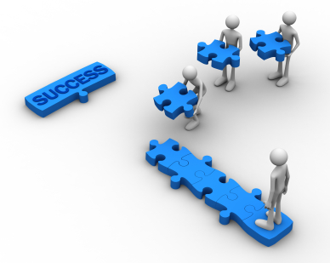
What is the value in this for students?
“On several occasions, we approached people of authority for help,
information, donations, etc. It helped us build our confidence and
also to come out of the high school shell we’ve kind of gotten into.”
“This project basically made us go out into the world and interact with
people of a higher position. One thing that really built our confidence
was when Danya replied to our first email and commended us on
our proper English. She is a former English teacher so getting
that response definitely made us feel good!”
“You learn to be a better person and that the world doesn’t actually revolve around you. You learn more about the problems that surround you on a day to day basis.”

Slide 24
And now that it’s over…
I would have to say this has been a tremendously rewarding project. There are things that I would tweak if I were to do this again, however for the most part it ran quite
smoothly for something that could get very busy at times.
By allowing the kids to choose their own groups and goals, they immediately became
intrinsically motivated. My main job was to oversee everything, meet with each
group regularly, check & update the Wiki, offer support and suggestions. The students took care of everything else. The more hands-off I was, the more the students got out of their projects. I will definitely be using PBL as a teaching method in the future.
PBL 2011 – 2012
$6,302.25
And Counting…

