Slide 1
Following Their Voices
Sharing our student, parent & teacher voices
at our Open House on April 11th/19

Slide 2
Following Their Voices is an initiative designed to raise the educational achievement and participation of Saskatchewan's First Nations, Métis and Inuit students. Following Their Voices focuses on enhancing relationships between students and teachers, creating structures and supports for teachers and school administrators to co-construct teaching and learning interactions with students and creating safe, well-managed learning environments.

Slide 3
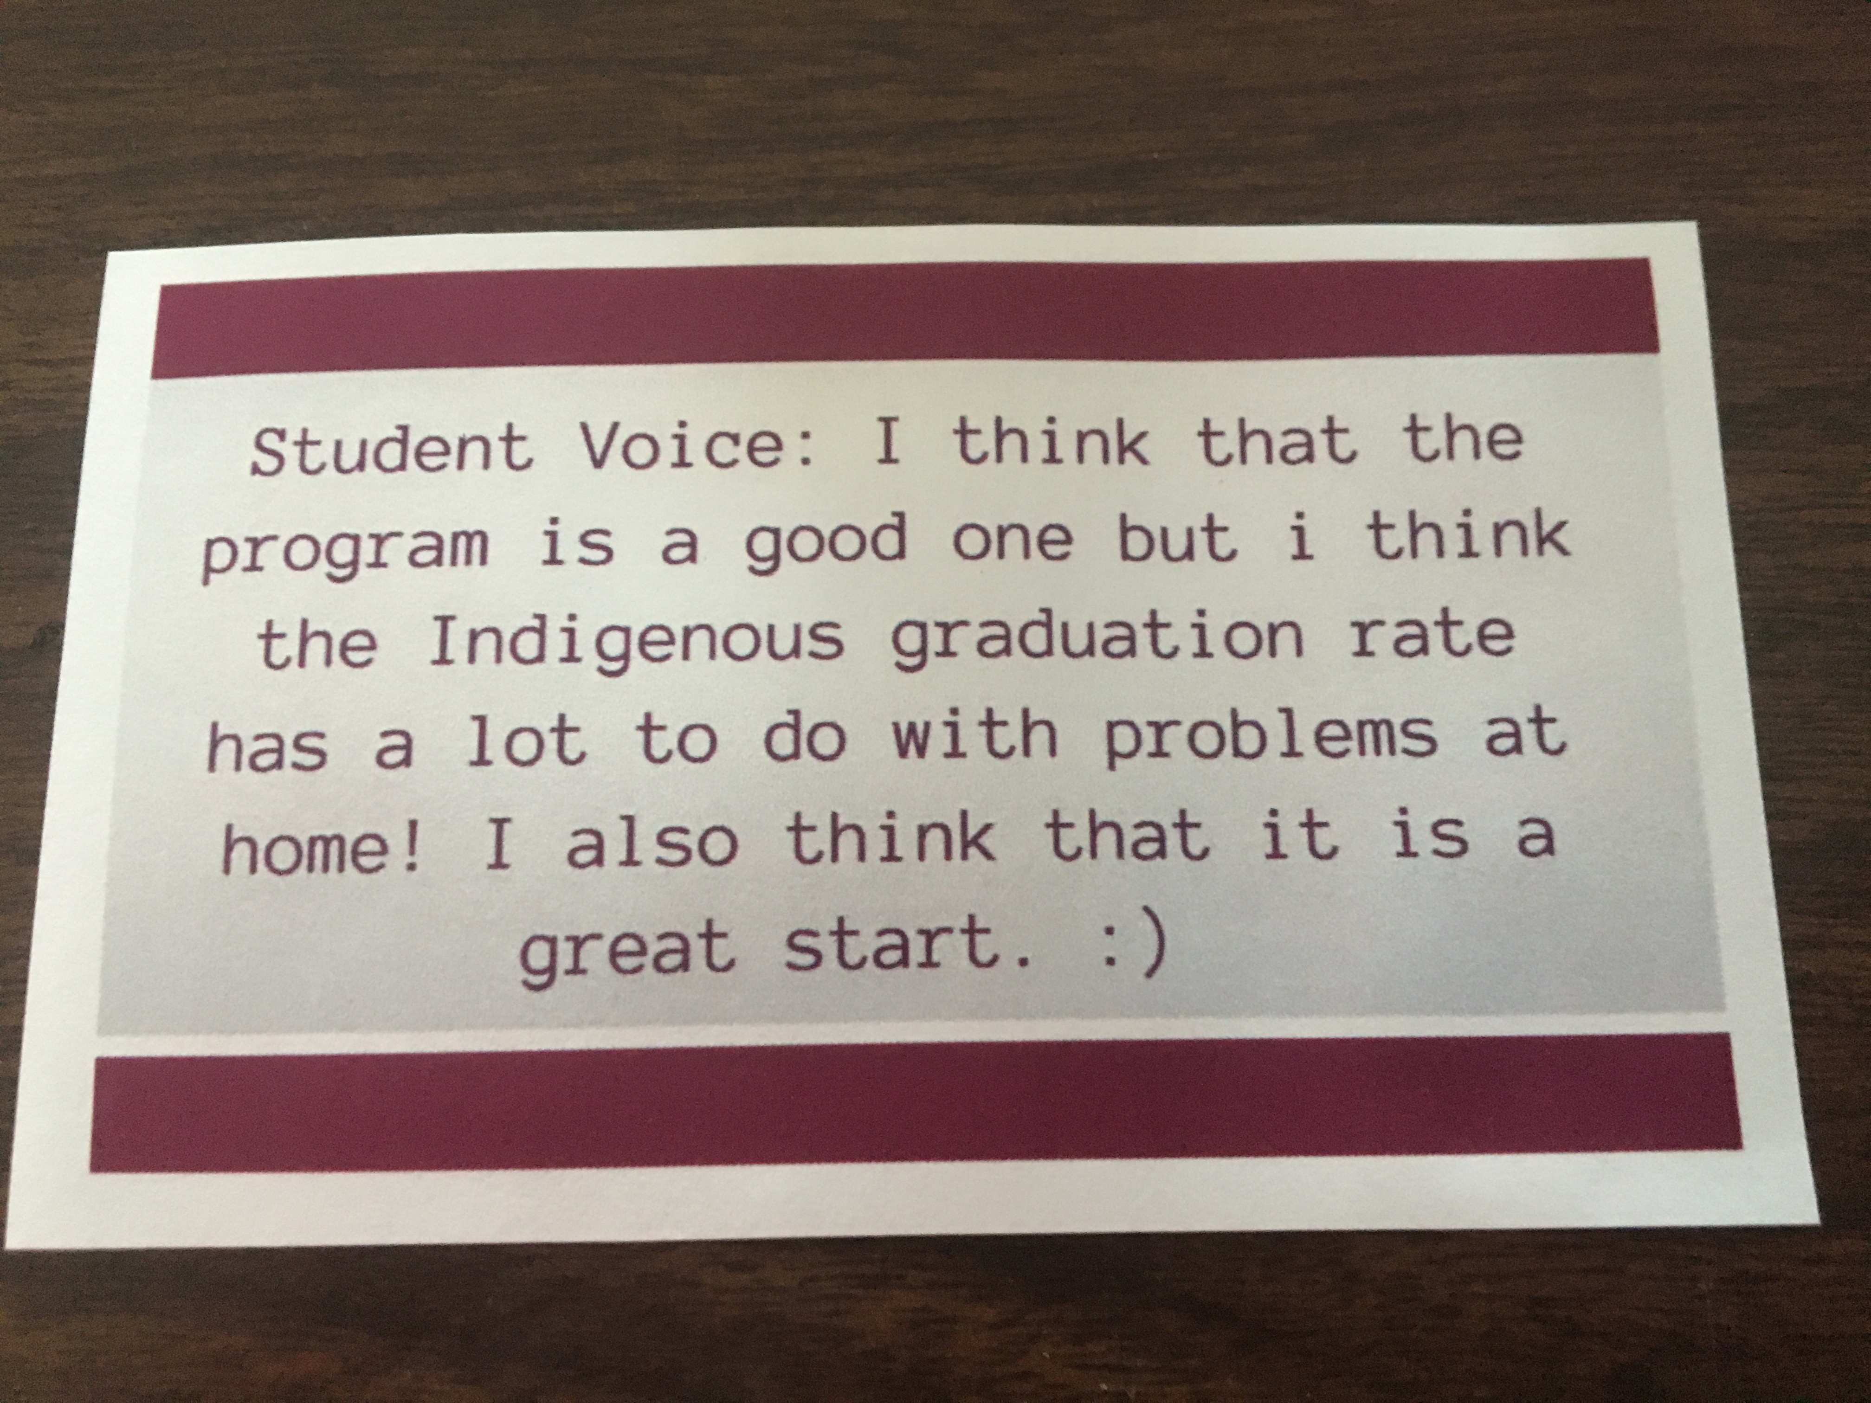
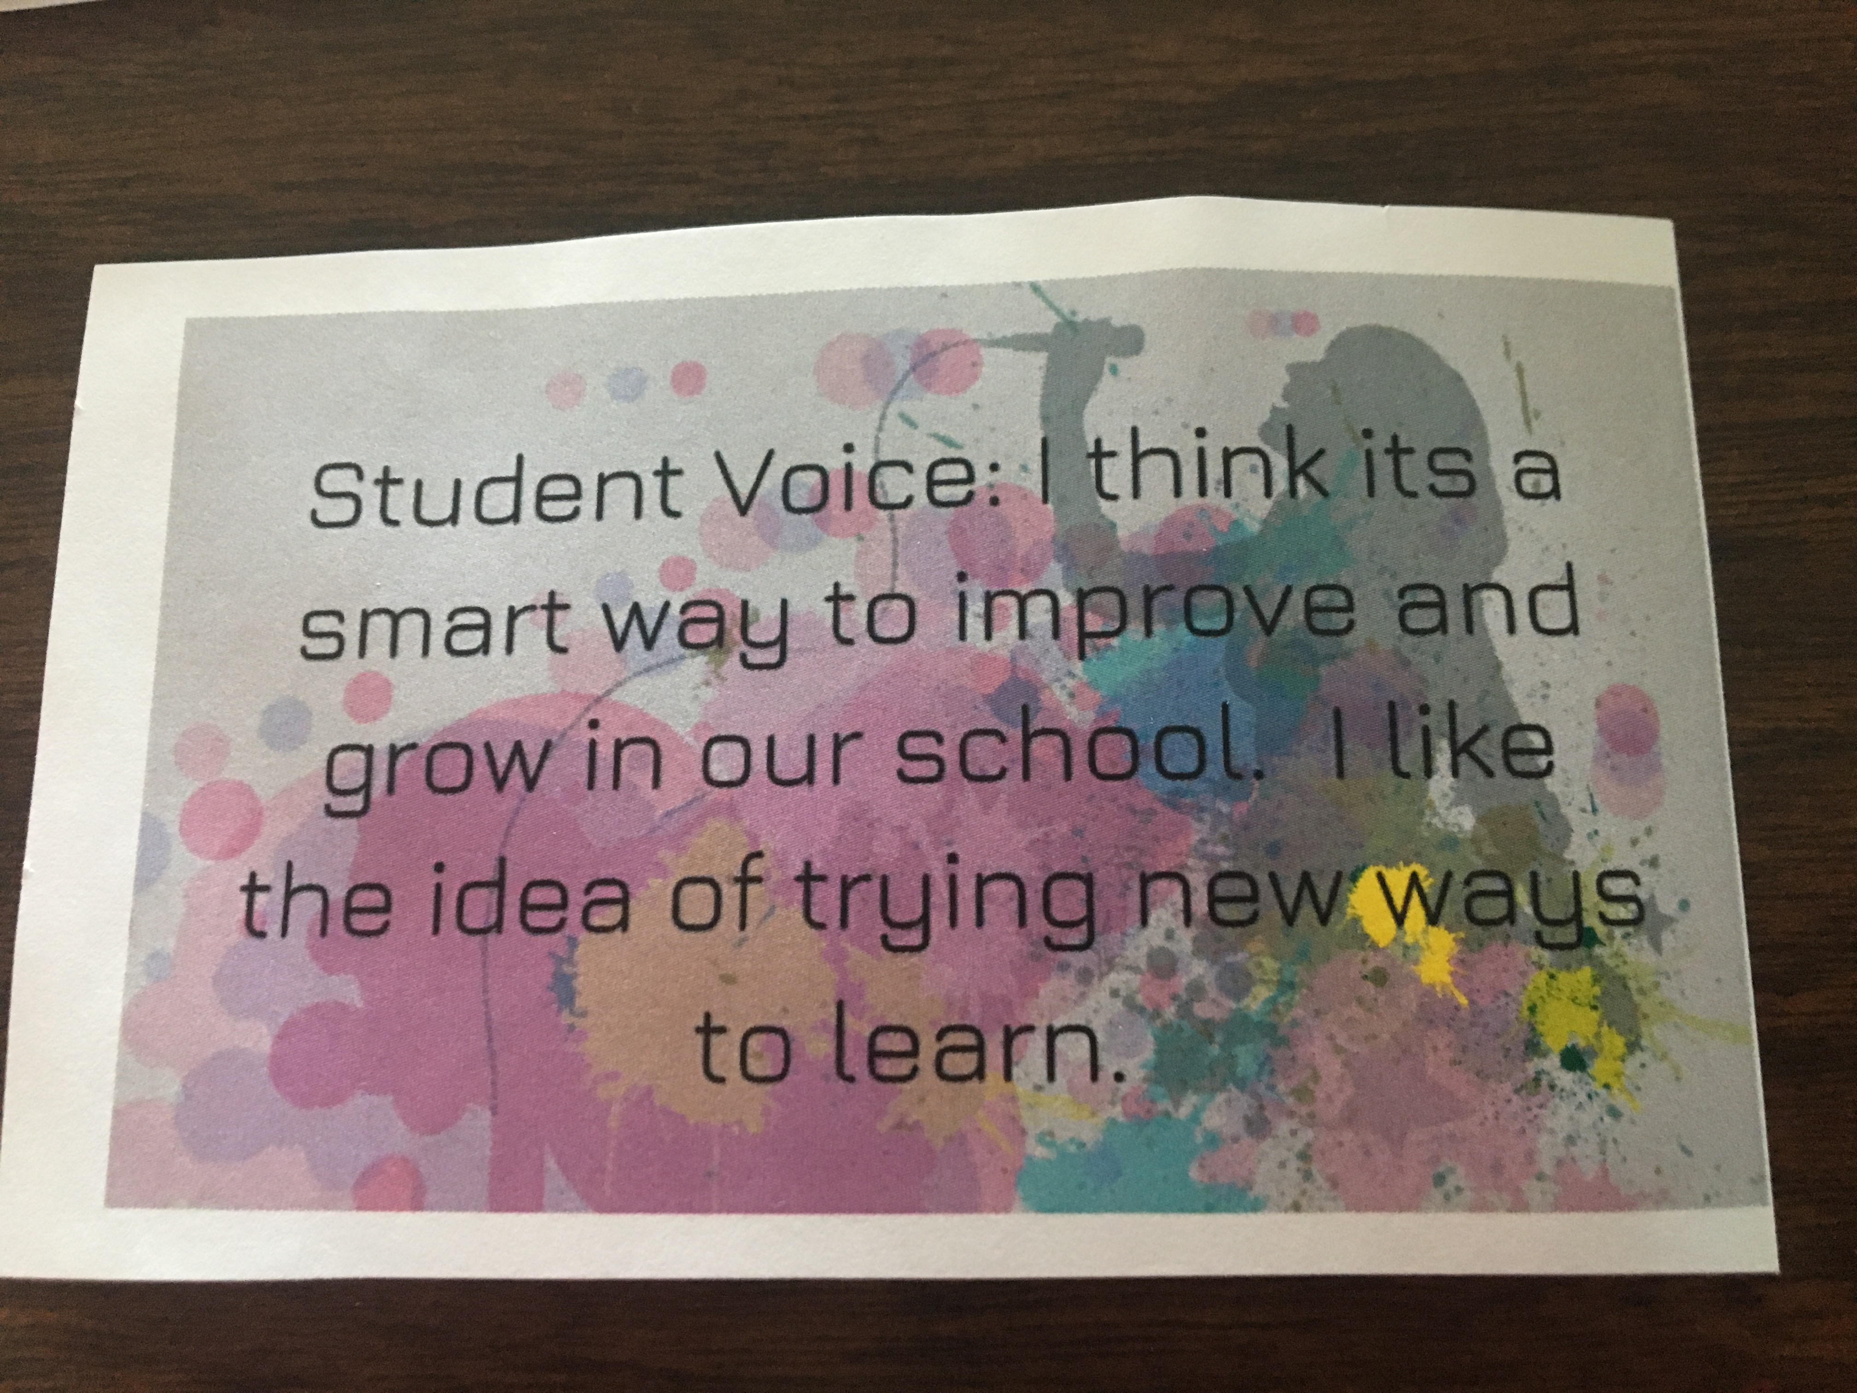

Slide 4
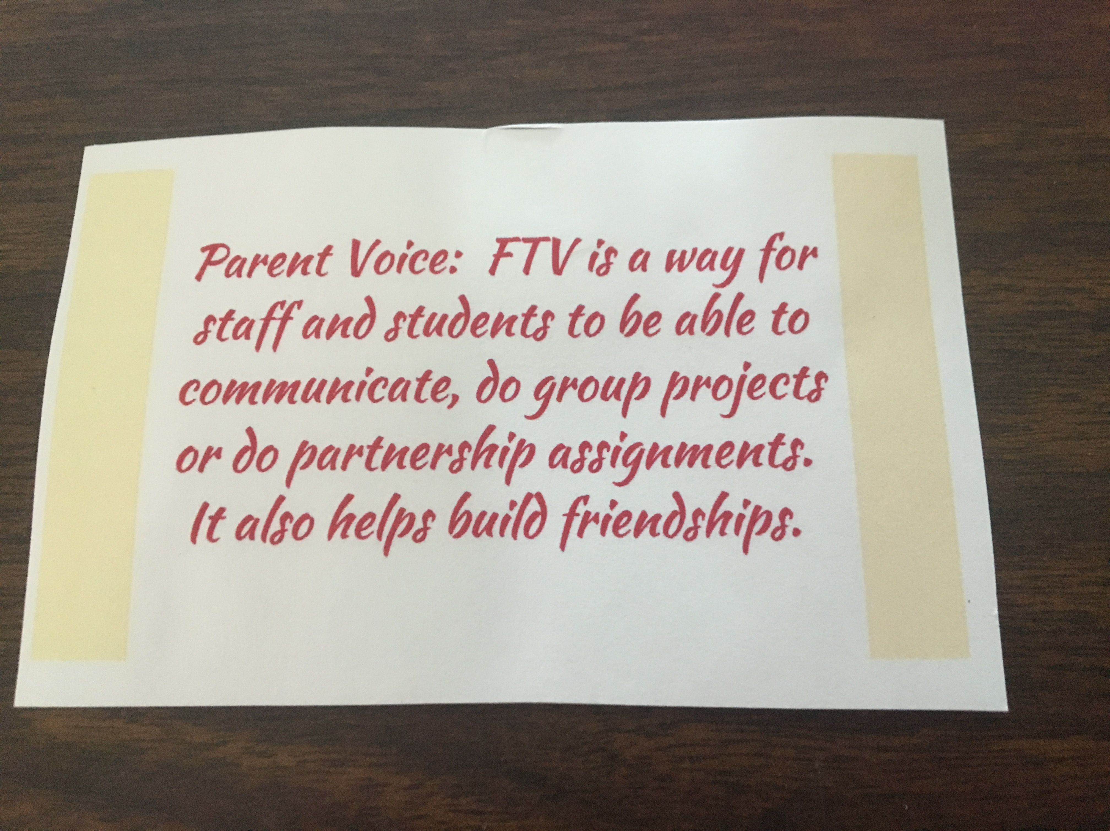

Slide 5
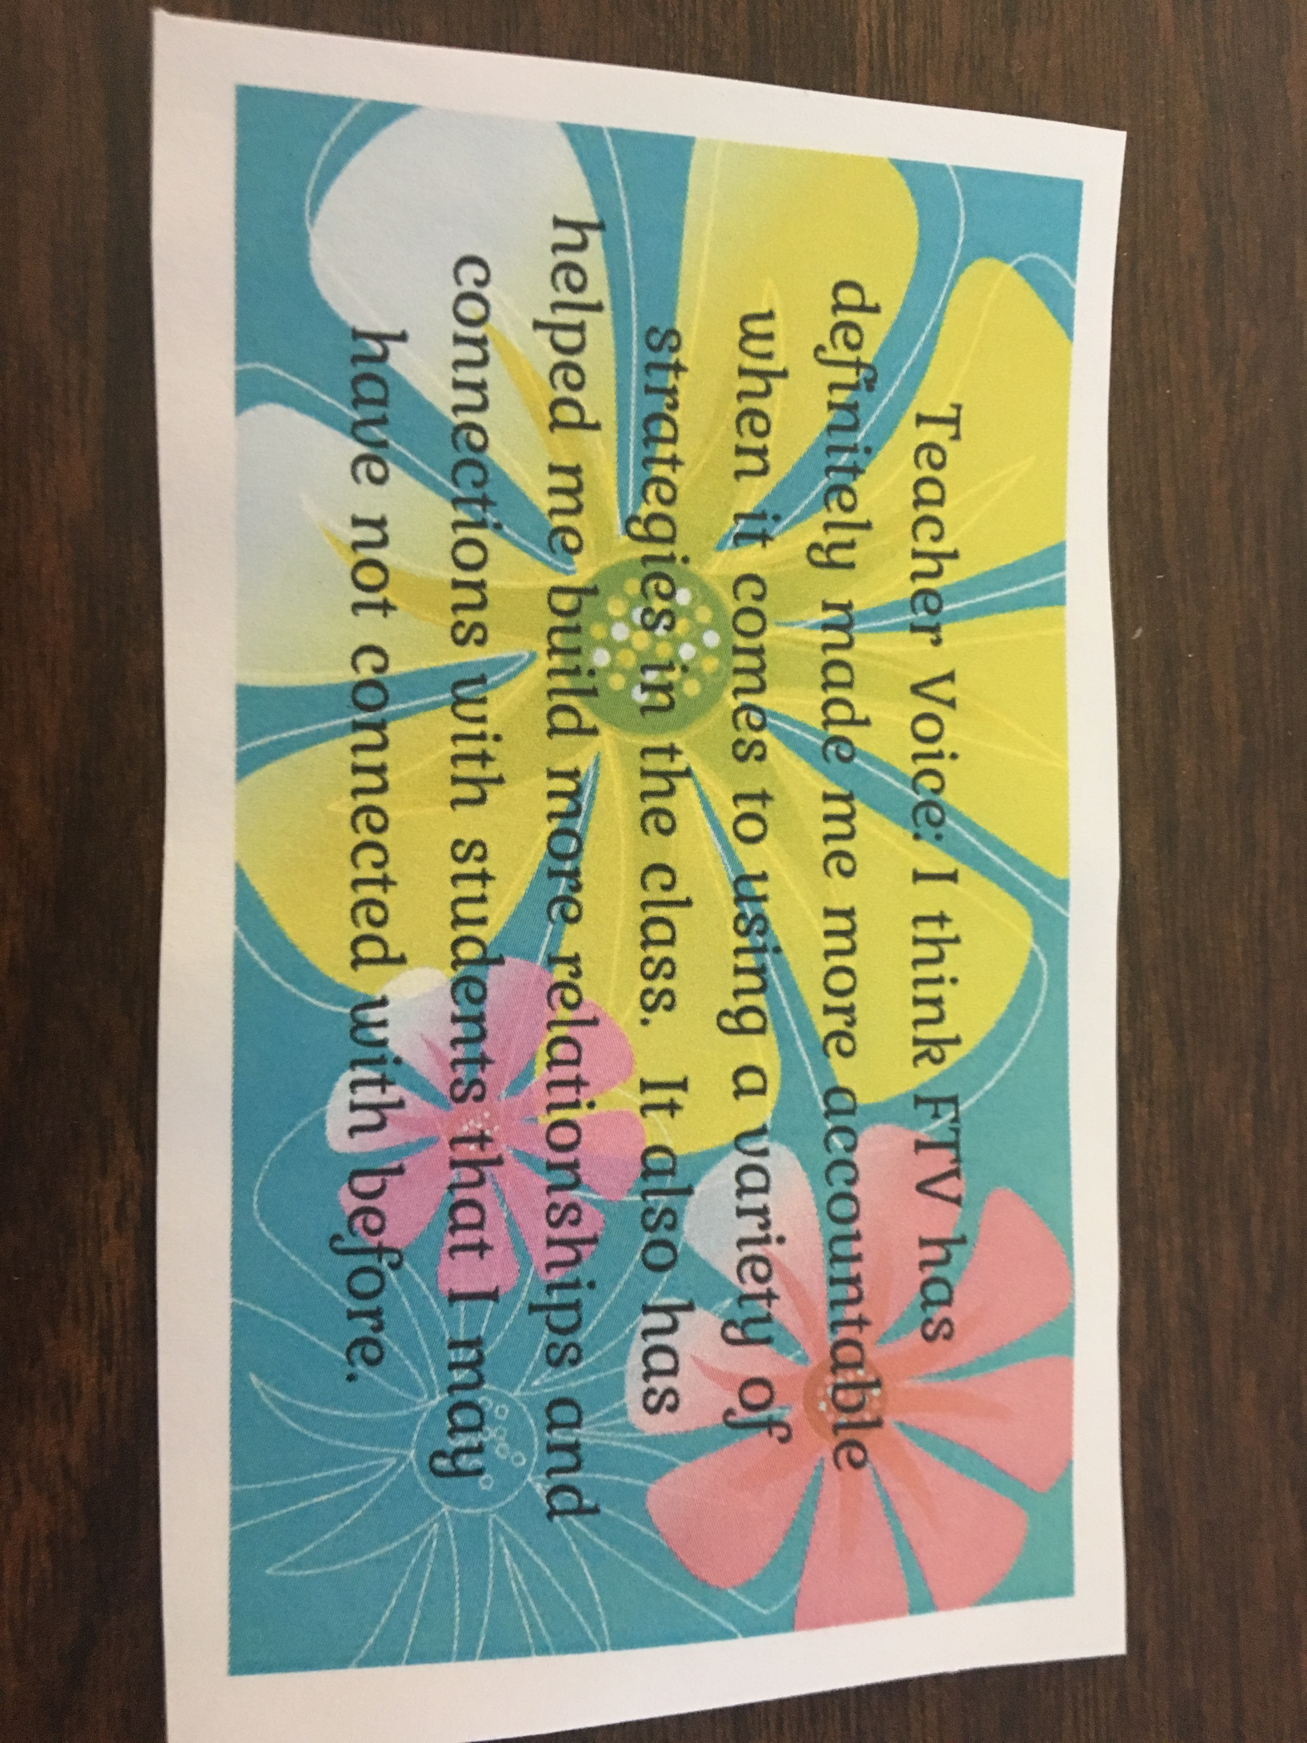
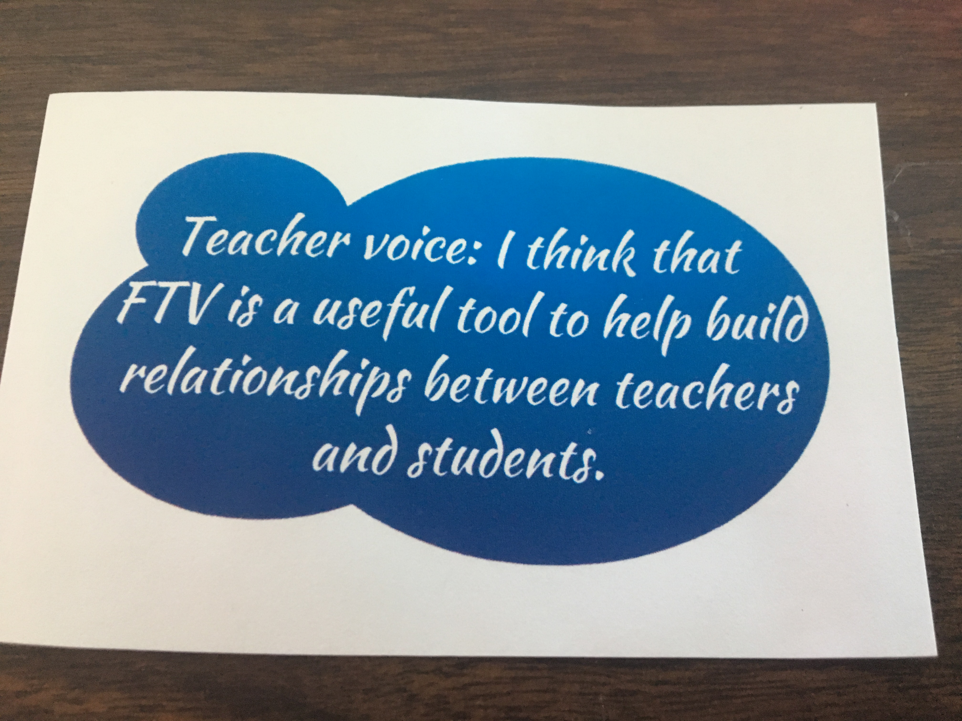

Slide 6
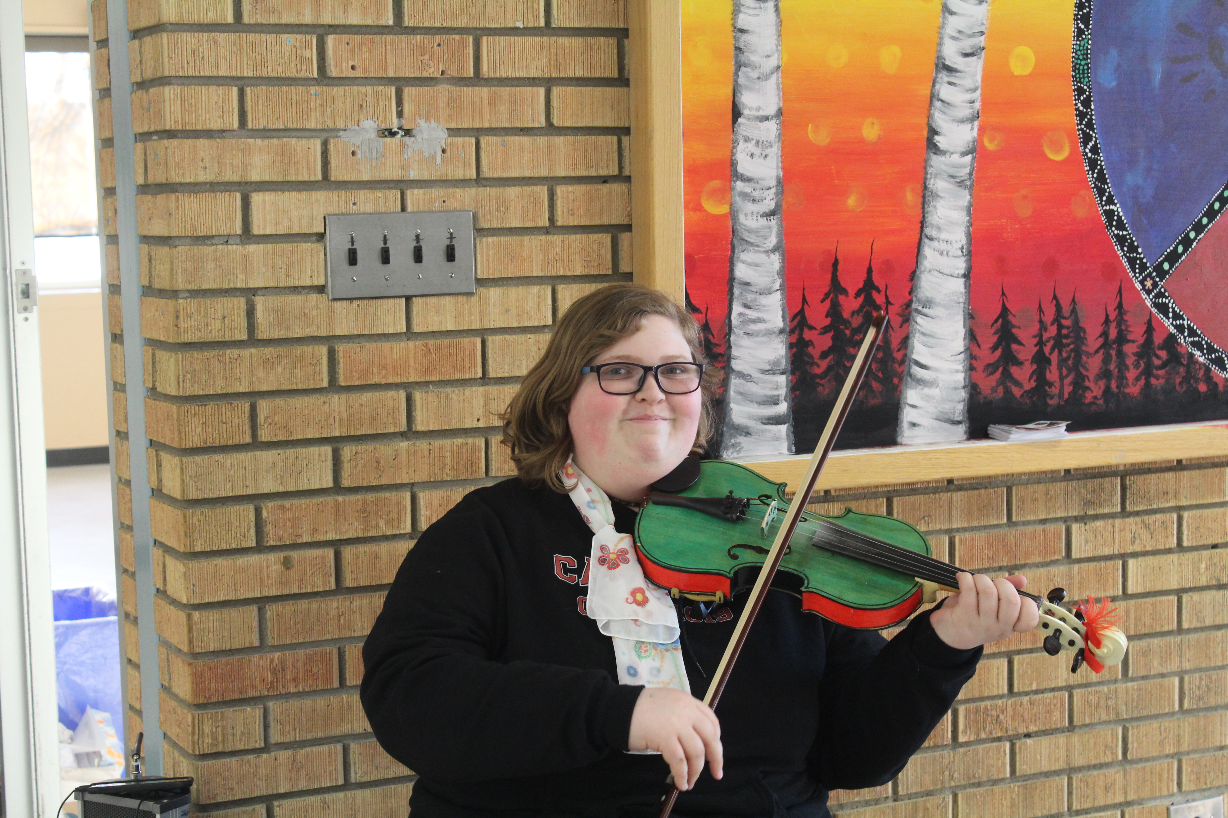
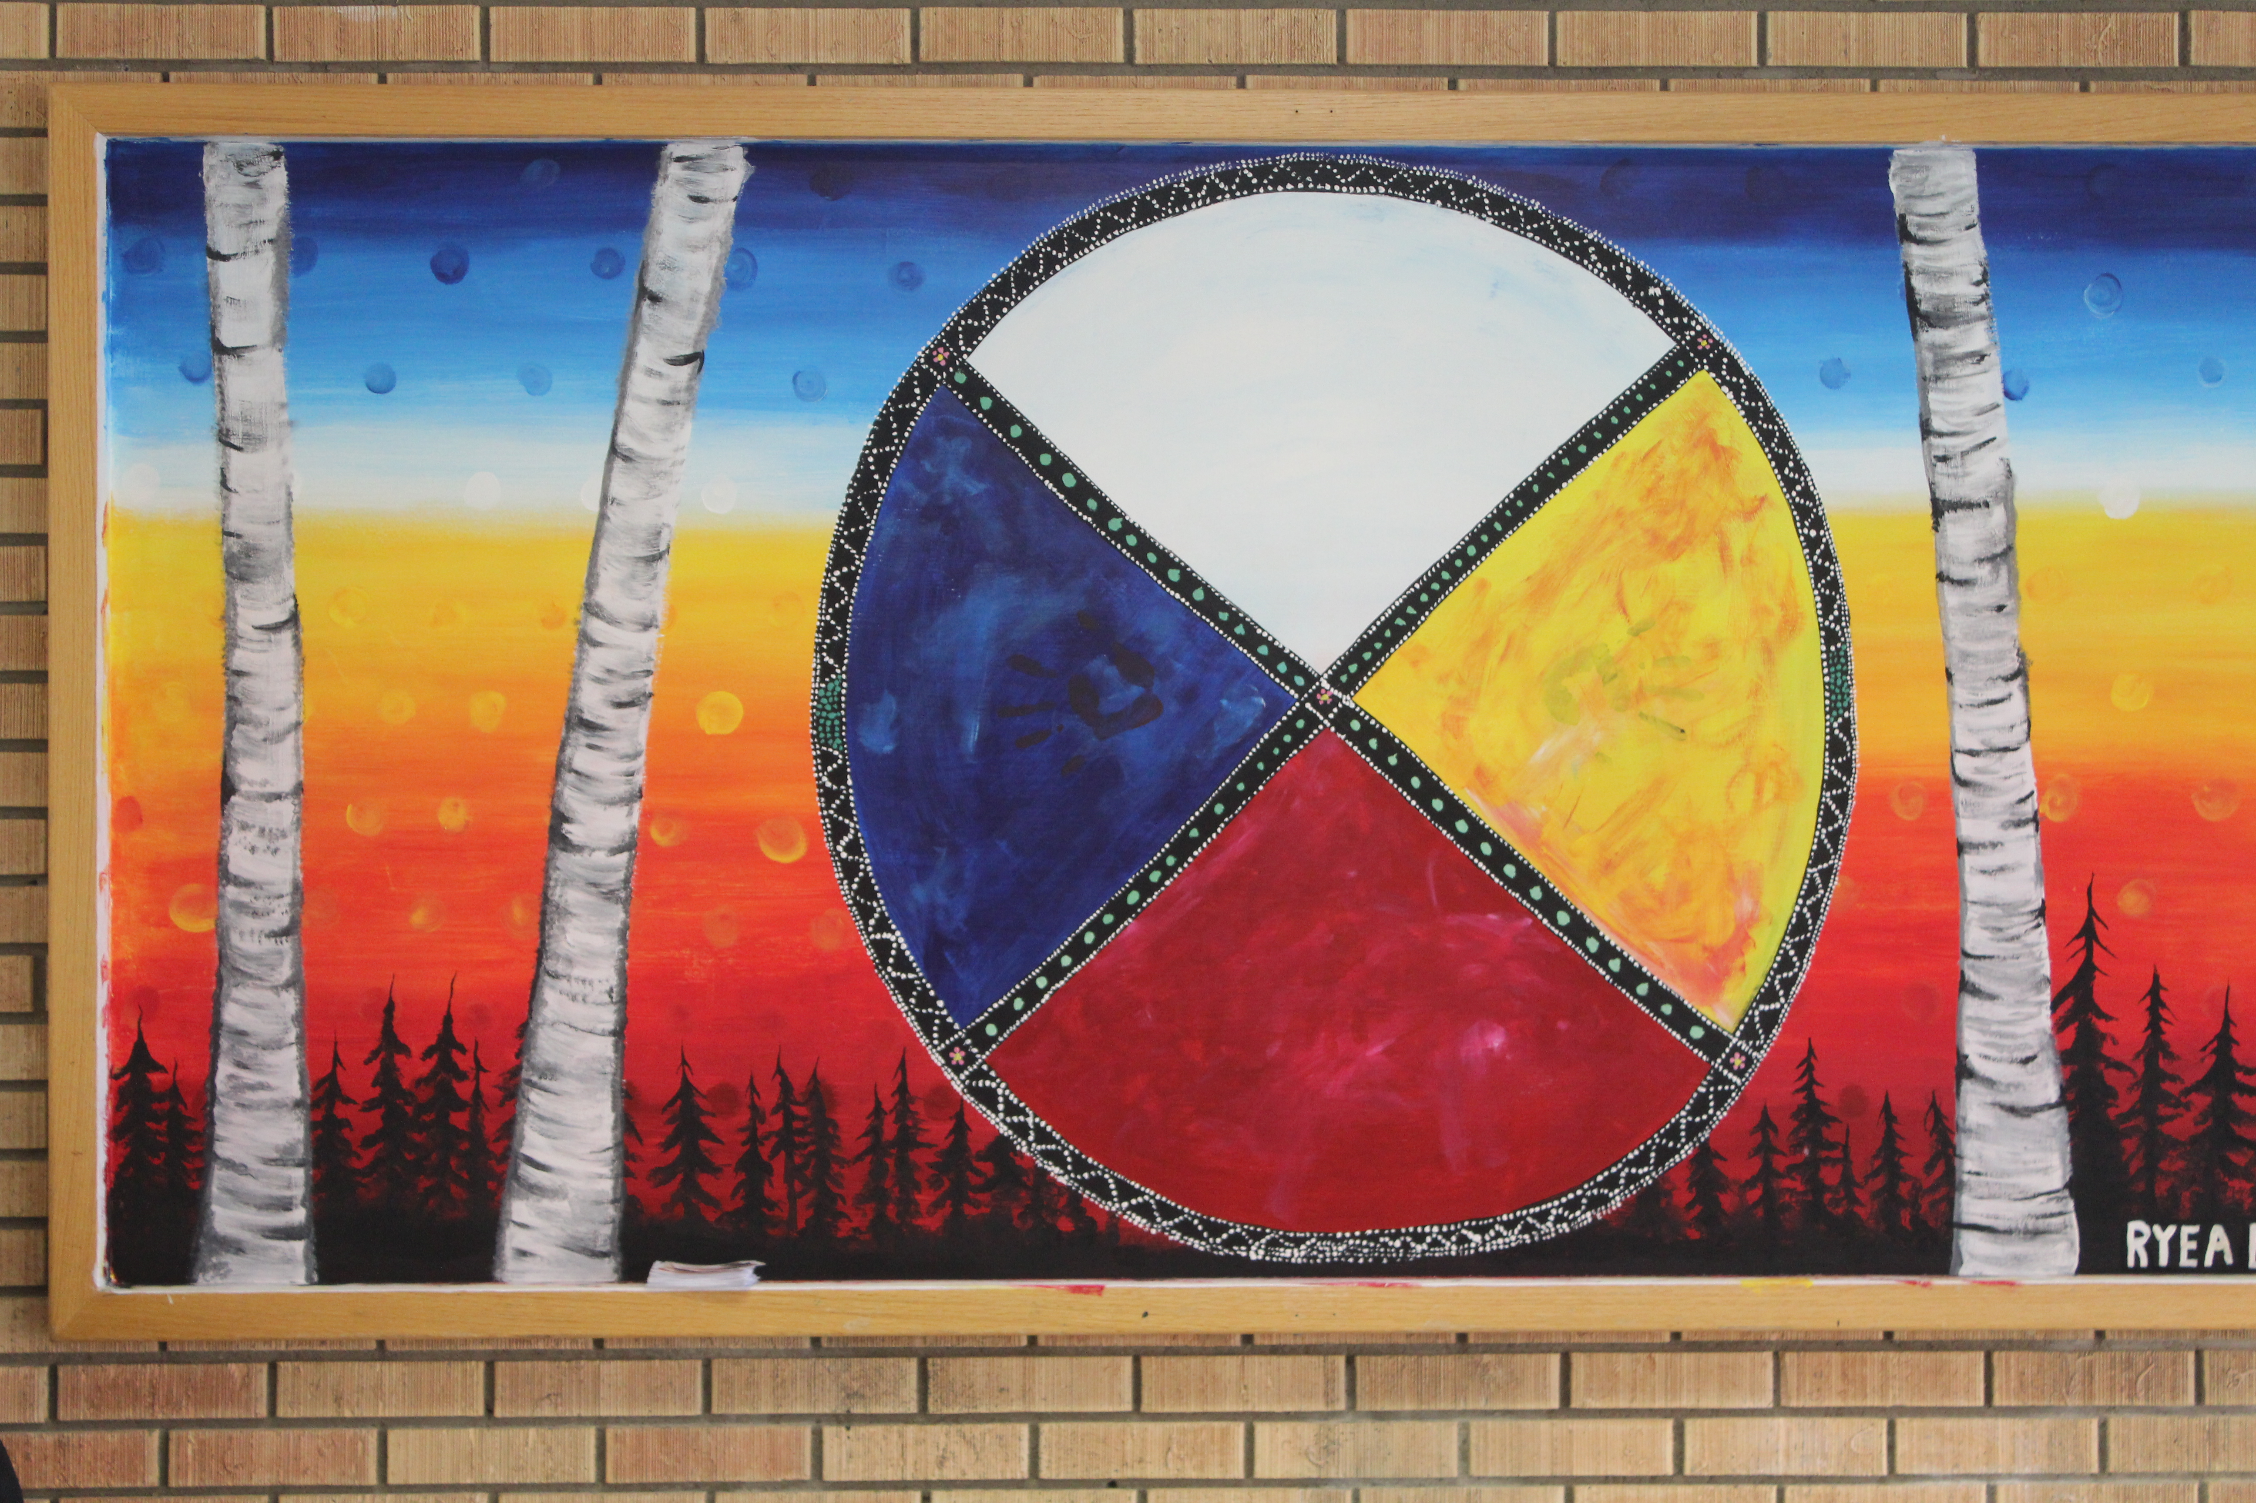
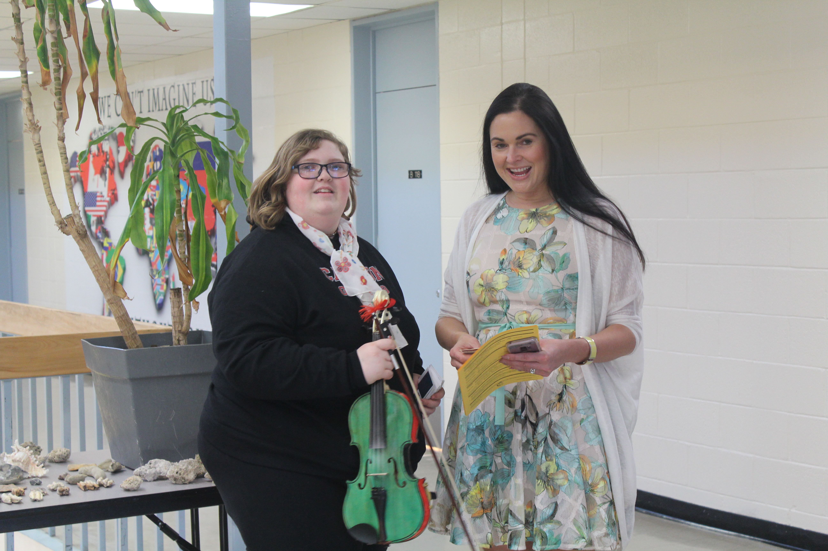
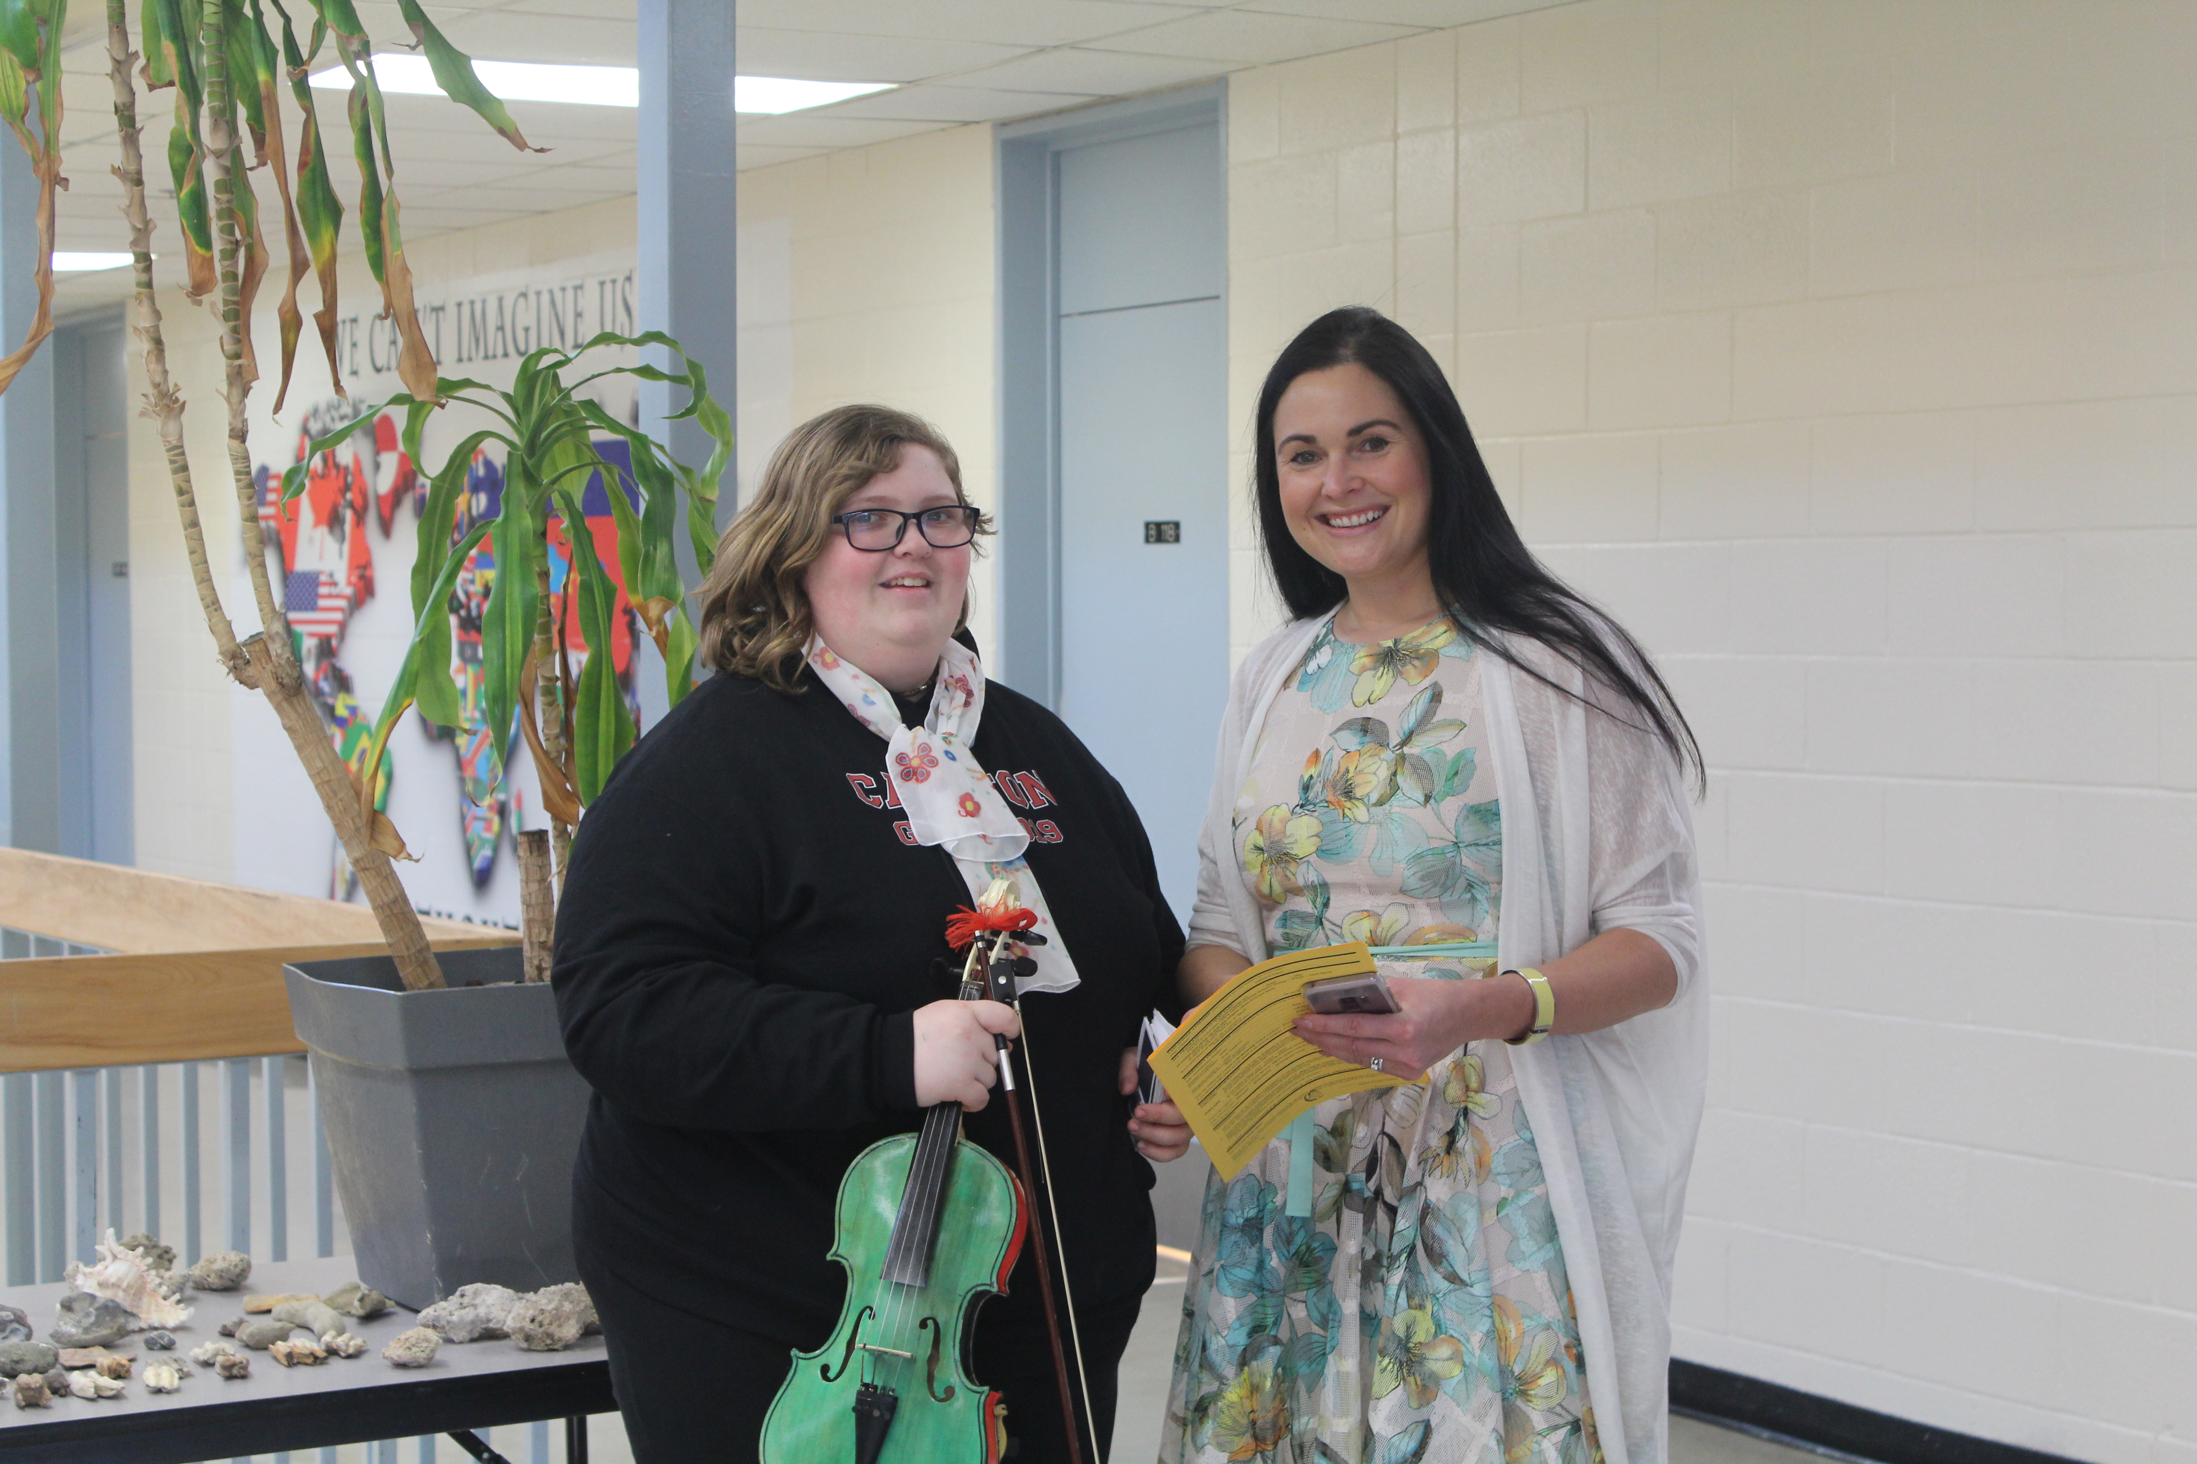
Open House
April 11th/19

