Slide 1
Sharing our Voices
Following Their Voices Initiative
April 2019

Slide 2
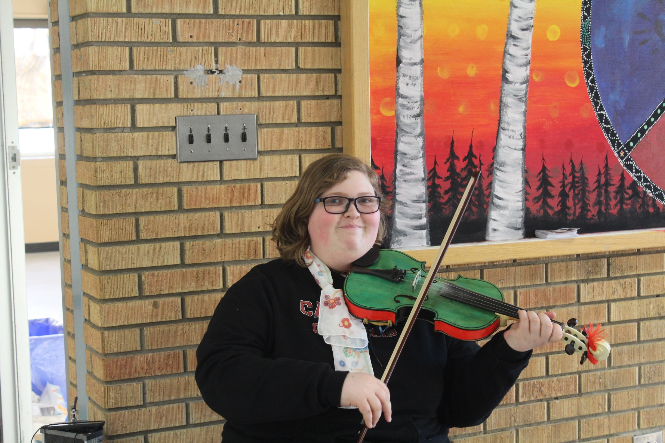
Open House at Carlton Comprehensive Public High School – Prince Albert, Sask.

Slide 3
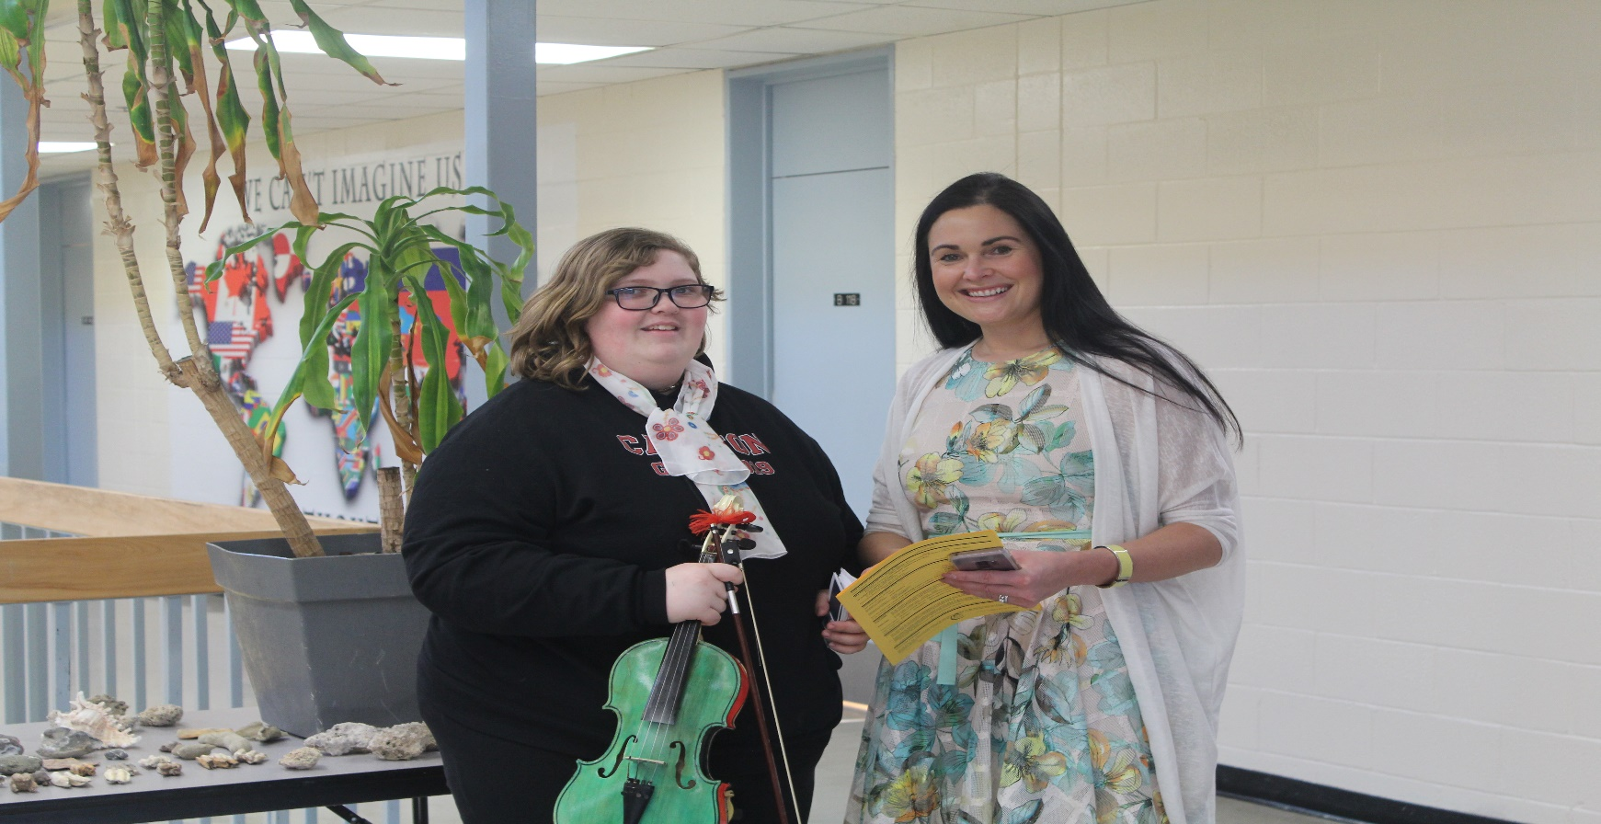
Trinity sharing our voices with our vice principal Mrs. Cey

Slide 4
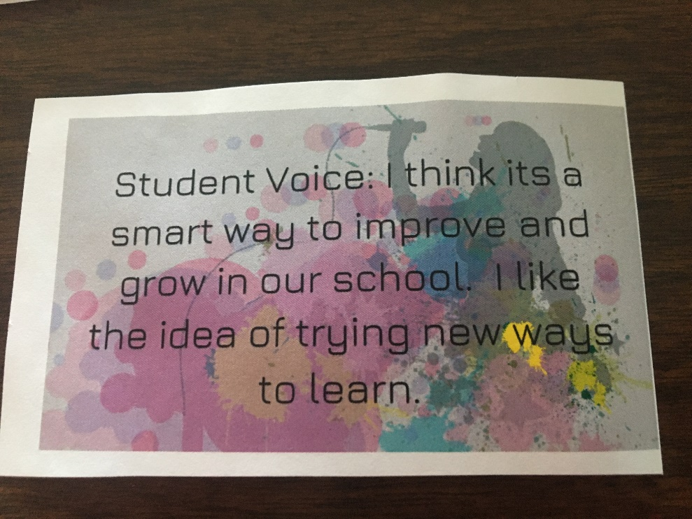
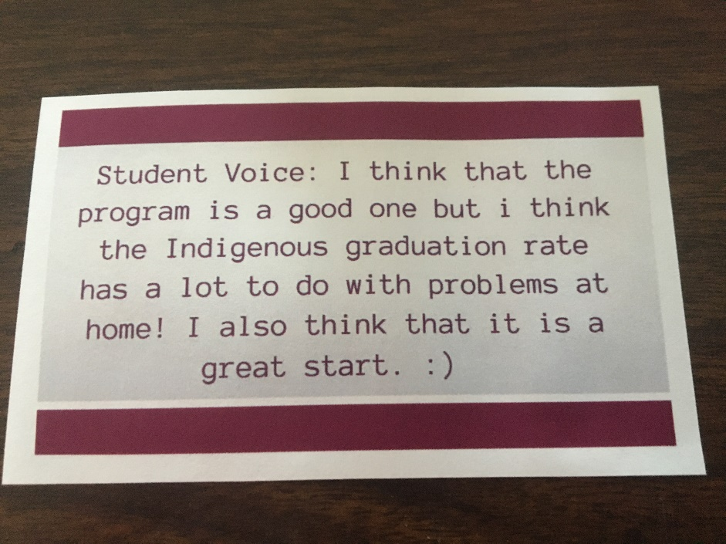
Student Voices

Slide 5
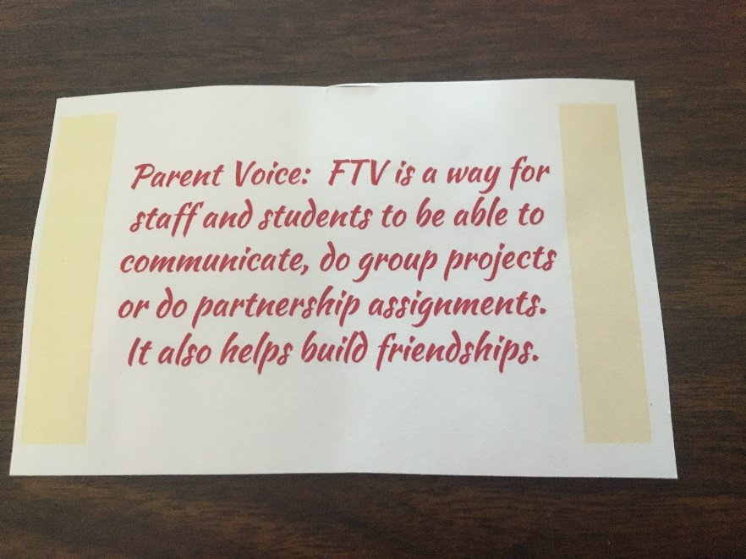
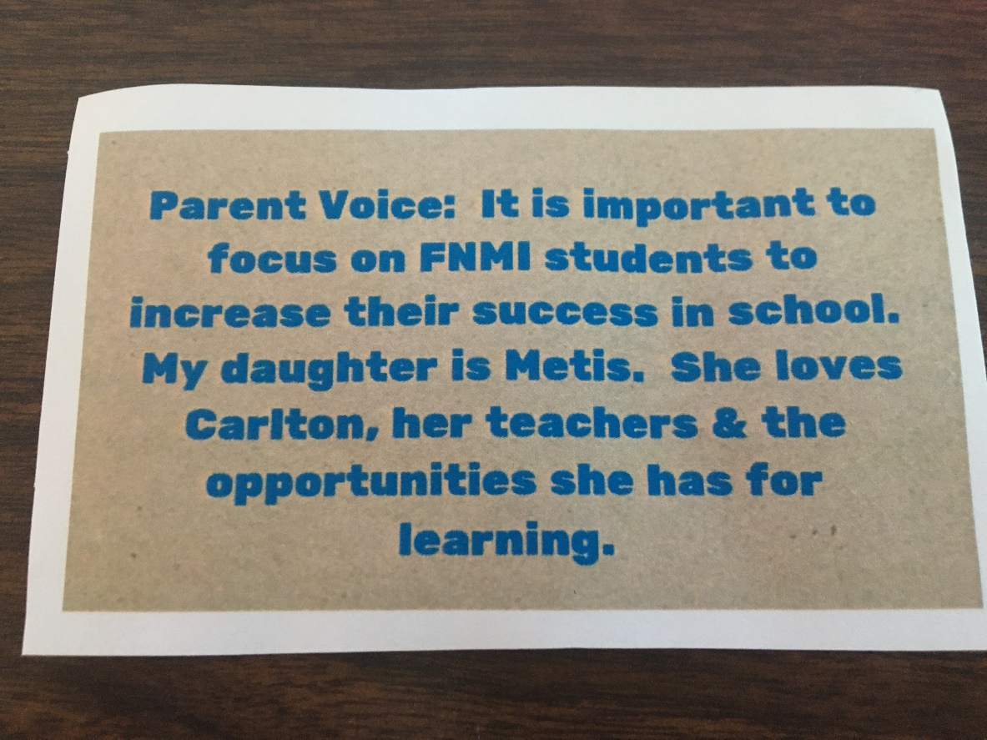
Parent Voices

Slide 6
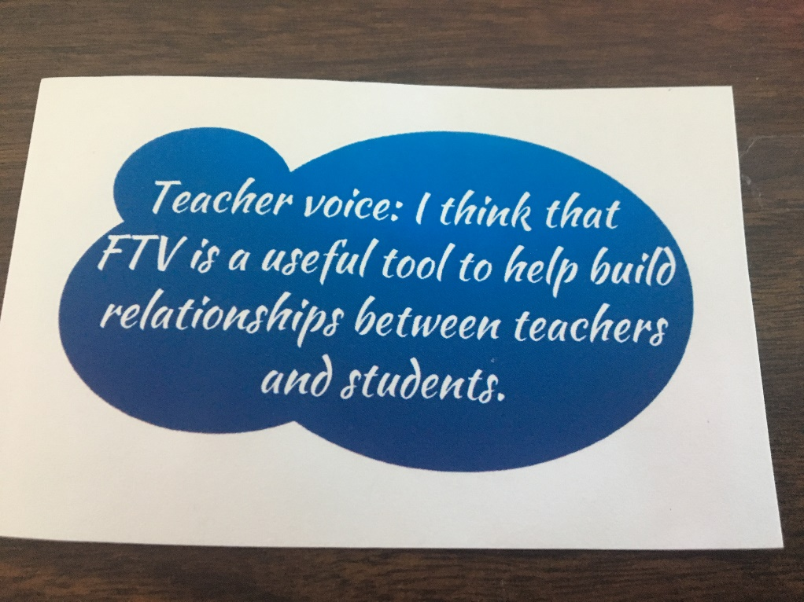
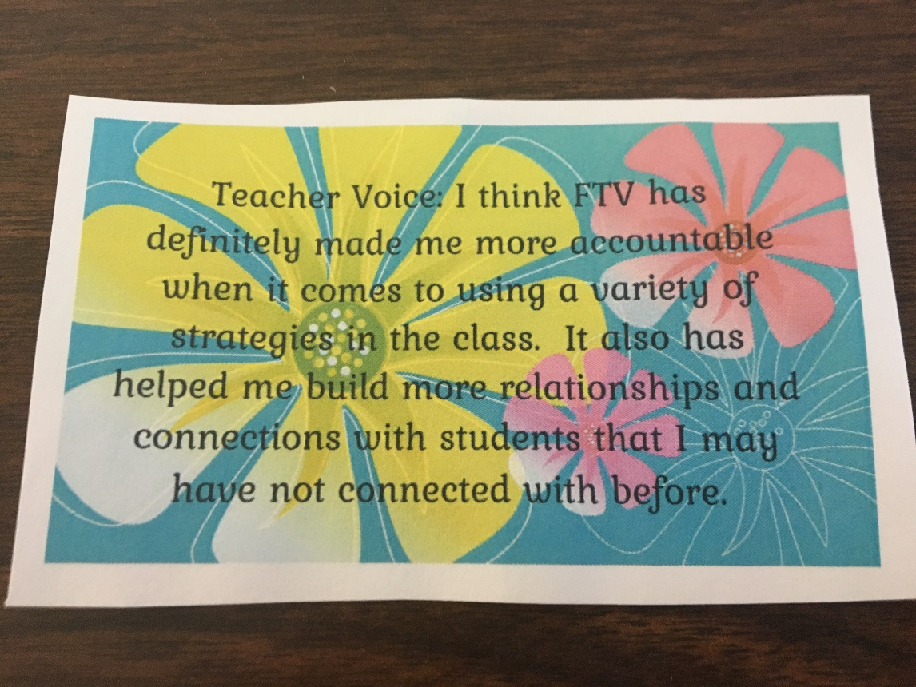
Teacher Voices

Slide 7
Thank you

