Slide 1
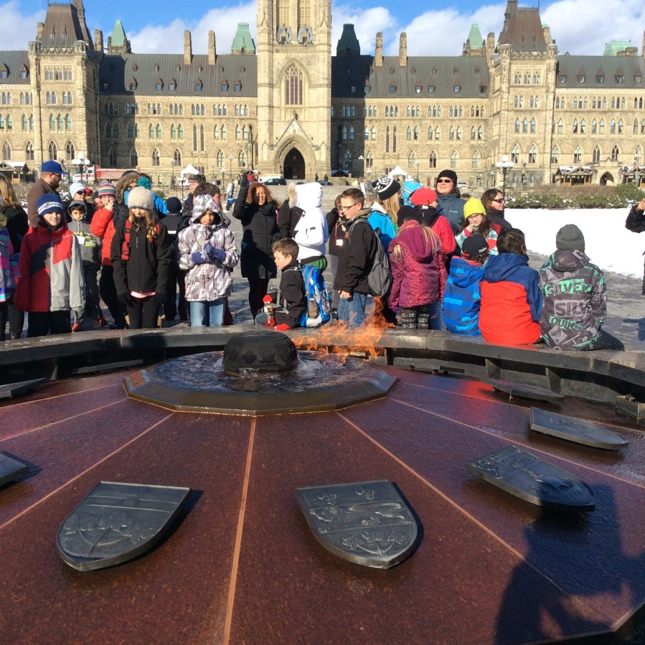
Keep the Promise
Representing New Brunswick in Ottawa

Slide 2
OUR TRIP!!!
Tommy Gyurko
Nick Rocca
Grade five
Geary Elementary Community School
New Brunswick

Slide 3
The promise
In 1989, the government made a promise to eliminate child poverty in Canada by the year 2000.
There are more children living in poverty now than there was then.

Slide 4
How many kids
1 in 7 children in Canada are living in poverty
1 in 4 First Nations children are living in poverty

Slide 5
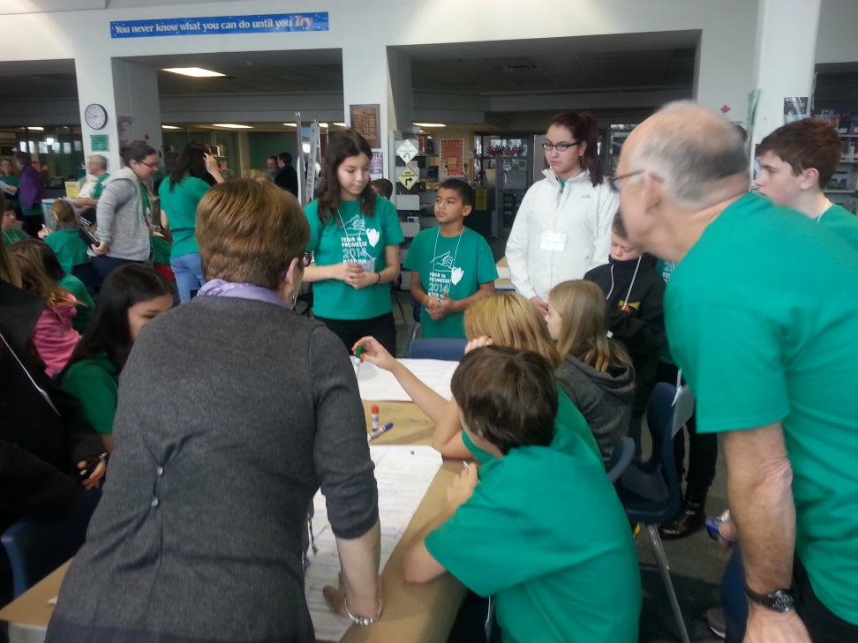
The five problems
Food
Shelter
Education
Recreation
Local and Regional Concerns
Cycle

Slide 6
Our Trip to the Food Bank
Who uses the food bank?
How does the food bank operate
841 191 Canadians turn to food banks every month
One third of these people are childern

Slide 7
Change For Change
What could we do?
What is change for change?
Imagineaction project grant
Food bank video
Donate Food

Slide 8
Keep the promise garden
2 000.00 grant from Breakfast Makes Me Shine
10 garden beds
1 per class room
Nutrition programs here at the school

Slide 9
It really matters

